Slide 1


FLEET MANAGEMENT DIVISION
  FMD Web Site:
  www.fleet.wv.gov
  Phone # 855-817-1910
  ARI Maintenance:
  https://ariinsights.arifleet.com
  1-800-CAR-CARE (800-227-2273)
  ARI Fuel:
  https://ariinsights.arifleet.com
  1-800-505-4939 (Problems at the Pump)

Slide 2
FLEET MANAGEMENT DIVISION
Legislative and policy concerning state owned and operated vehicles
  HB4015
  HB103
  Administration Rule Title 148 Series 3 State-Owned Vehicles
  Administrative Policy, Employee Use of Employer Provided Motor Vehicles
  Complete versions can be found on the Fleet Management Division’s Website

Slide 3
FLEET MANAGEMENT DIVISION
HB4015
  Passed during the 2018 Legislative Session, effective June 5,2018
    Establishes the requirements of governing the use of state vehicles
    Reporting requirements and responsibilities for fleet coordinators
    Information to be collected and maintained on state vehicle log sheets
    Manner for each spending unit to report to the division and the information that shall be collected and maintained
    Requirements and polices governing commuting and take home state vehicles
    The DMV relicensing project
    Annual report
    Auditor’s Office 20% compliance

Slide 4
FLEET MANAGEMENT DIVISION
HB103
  Passed during the 2018 Legislative Session, effective June 5, 2018
    Added a requirement to HB4015 that requires spending units to send FMD a list of bona fide noncompensatory business reasons for which a state vehicle is being provided to each employee on or before July 1st each year

Slide 5
FLEET MANAGEMENT DIVISION
Administration Rule Title 148 Series 3 State-Owned Vehicles
  Authority §5A-3-48, 5A-12-5
    Effective 3/1/18
    Expands on HB4015
    Provides dates and identifies the data and information that needs to be maintained and reported

Slide 6
FLEET MANAGEMENT DIVISION
Administrative Policy, Employee Use of Employer Provided Motor Vehicles
https://fleet.wv.gov/new-driver-orientation/Documents/Governor%27s%20Policy%20effective%2010-31-18.pdf
THIS POLICY IS TO BE REVIEWED BY EACH DRIVER OF A STATE OWNED VEHICLE.
A COPY OF THIS POLICY SHOULD BE KEPT IN EACH EMPLOYER PROVIDED VEHICLE

Slide 7
FLEET MANAGEMENT DIVISION
HB4015 defines a state vehicle as;
“State vehicle” means, for the purpose of this article, a vehicle with a rating of one ton or less that is owned, purchased, or leased by any state spending unit, on which a state vehicle license plate is required, where the use of such vehicle is paid for with public funds regardless of the source of such funding, but does not include all-terrain vehicles (ATVs) or vehicles requiring a commercial driver’s license to operate;
Fleet Management Division purview is for those vehicles with a classification of 1 ton and under. The vehicle classification and GVWR are two different items. These vehicles are listed as Category 2 in Oasis.

Slide 8
FLEET MANAGEMENT DIVISION
HB4015
§5A-12-7. Spending unit duties and responsibilities.
(a) Every spending unit shall report all vehicles and equipment requiring a state license plate, including those vehicles with a rating of more than one ton, those requiring a commercial driver’s license to operate, and all-terrain vehicles, as fixed assets in the centralized accounting system maintained by the Enterprise Resource Planning Board.
(b) Every spending unit that owns state vehicles shall annually affirm to the State Agency for Surplus Property on or before July 15 of each year, that the vehicles and assets reported to the centralized accounting system as required by §5A-12-7(a) of this code are accurate and current .

Slide 9
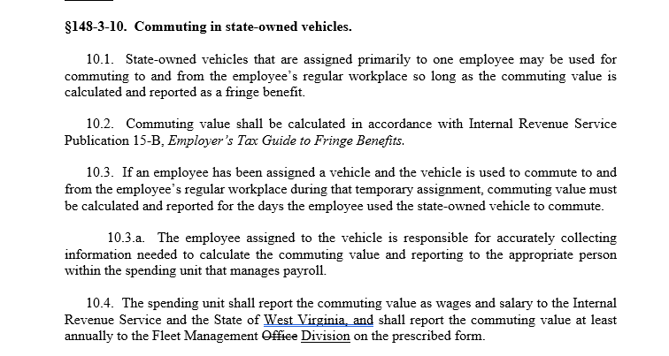
FLEET MANAGEMENT DIVISION

Slide 10
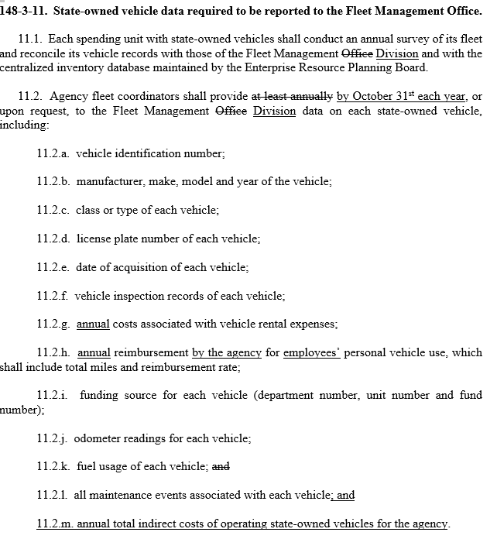

Slide 11
FLEET MANAGEMENT DIVISION
What does FMD do?
  FMD provides the tools and mechanisms to the state agencies for the efficient management of state vehicles
    Provide fueling and maintenance
      4,000 using fueling services
      3,000 using maintenance services
    Financing to acquiring vehicles
      2,800 vehicles owned by FMD and operated by the various state agencies
    Facilitate the transferring and/or decommissioning of vehicles
    Maintain an accurate list of state vehicles owned or leased
      6,900 1 ton and under
      1,700 Over 1 ton
      1,600 Licensed nonmotorized units
    Report annual to the Governor and Joint Committee on Government and Finance by December 31, 2019

Slide 12
FLEET MANAGEMENT DIVISION
What we have been doing
Returned $1,389,731.83 to State Agencies
    April 2017 credited $691,179.73
    May 2017 credited $698,552.10
Partnered with our Maintenance Vendor ARI
    April 2016 - FMD uploaded all vehicle data in ARI
    May 2016 - FMD began interfacing the WEX fuel data into ARI to better report on total cost per vehicle
    August 2016 -New ARI Insights Dashboard revealed
    January 2017 - FMD created LOV Report for Agency fleet reviews
    July 2017 - FMD combined the Maintenance and Fuel Contracts to gain better vehicle cost reporting, simplify to one vendor and save the State money

Slide 13
FLEET MANAGEMENT DIVISION
What we have been doing
October 2017:Completed the State Licensed Inventory Project which included Motorized and Non-Motorized licensed assets
November 2017: Issued and distributed 4600 new ARI Fuel-Only Credit Cards
March 2018: Created a crosswalk between the Finance Division’s billing codes and the State’s Dept and Unit numbers
March 2018: Changed the Cabinet level names in ARI to match the wvOASIS Dept and Unit rollups
April 2018: Completed the 2018 Inventory Integrity Project to verify 20 vehicle attributes

Slide 14
FLEET MANAGEMENT DIVISION
What have we been doing
MV18 Contract: Assisted in acquiring/processing 527 vehicle requests
  92 Agency Owned
  356 Financed by FMD
  5 Reassigned
  74 Decommissioned
July 2017 – March 2018: Collected and uploaded 26,235 odometer readings
July 2017 – March 2018: Processed and tracked 96 state vehicle/driver complaints and toll violations
July 2017 – March 2018: Processed 360 rental vehicle reservation requests
July 2017 – March 2018: Completed 20 Agency Fleet Reviews covering 80% of the State’s licensed inventory with focus on inventory, maintenance and fueling cost along with highlighting the LOV report and the ARI Dashboard to assist with lowering operation cost.

Slide 15
FLEET MANAGEMENT DIVISION
Where we are going
Telematics Pilot Program through ARI
  50 units with DEP
    20 GeoTab
Kiosk with online reservation, monitoring and reporting
  A online reservation and scheduling system for pool or shared vehicles
    Vehicle keys are dispensed through an ATM-like box by a authorization code
      Provides reports to provides agencies the data to maximize the utilization of pool/shared vehicles
      Provides data to agencies to reduce fleet size and correct sized vehicles

Slide 16
Agency Fleet Coordinator Schedule of Reporting Checklist
 | DATE | REPORTING REQUIRMENTS | INFORMATION FOUND
 | January 15 each year | Review driver understanding of all FMD vehicle policies and complete DOA-FM-011 form | Governor's Policy for State employee use of Employer Provided Motor Vehicles
 | January 1, 2019 | All state plates must be Gold with Blue lettering | DMV
 | July 1, 2018 | All vehicles must be in wvOASIS Fixed Assets | Surplus Property or wvOASIS HelpDesk
 | July 1, 2018 | DMV defines new naming convention for all titles | DMV
 | July 1 each year | All previous fiscal year Utilization Exemption Request forms are void and new forms must be submitted | DOA-FM-013 form and ARI General Info tab
 | July 1 each year | Spending unit names a Fleet Coordinator and submits to FMD | DOA-FM-006 form on FMD webpage
 | July 1 each year | New Insurance cards must be in every vehicle | FMD webpage
 | July 1 each year | Spending unit shall affirm all vehicles in Fixed Assets with Surplus Property | Surplus Property
 | On or before July 1 each year | Spending unit shall prepare and maintain a list of all employees who are provided a state vehicle and specify the bona fide noncompensatory business reasons for which the state vehicle is being provided to the employee | House Bill 103
 | July 31 each year | Spending unit shall report to Fleet Management Division the number of occasions off-hours/after-hours that a vehicle was used that has an approved Utilization Exemption Request for categories SEV or ERV. | Fleet Management Office to supply form to the Spending Unit.
 | September 1, 2018 | New plates, registrations and titles are to start being issued by DMV | DMV
 | October 1 each year | AFC are to report Mileage Reimbursement data to FMD | wvOASIS reports on Object and Sub-Object Codes. Call wvOASIS HelpDesk
 | October 1 each year | AFC are to report Rental Vehicle data to FMD | wvOASIS reports on Object and Sub-Object Codes. Call wvOASIS HelpDesk
 | October 1 each year | AFC are to report all vehicle / driver complaint data to FMD | AFC to track
 | October 1 each year | AFC are to report all vehicle operating costs to FMD | ARI Database and other information tracked by AFC
 | Midnight 12/31/18 | Green and White state license plates expire | DMV
 | 5th of each Month | Report requested Odometer Readings to FMD | Email request from FMD
 | Monthly | Ensures drivers report commuting miles on Vehicle Log Sheet and sends copy to FMD | AFC to collect from Drivers
 | Monthly | Reviews vehicle usage and submits Utilization Exemption Request forms as needed | DOA-FM-013 form and ARI General Info tab
 | Daily / As Needed | Ensures new drivers have valid license and completes the DOA-FM-023 form | AFC to track
 | Daily / As Needed | Complete DOA-FM-021 Vehicle Change Request form as needed | DOA-FM-021 form on FMD webpage
 | Daily / As Needed | Review ARI Dashboard for Alerts and Widgets | ARI insights Dashboard

Slide 17
FLEET MANAGEMENT DIVISION
wvOASIS Fixed Assets
Agencies must report all vehicles and equipment requiring a state license plate into wvOASIS Fixed Assets.
  One ton and under vehicles – Catalog Code 02
  Over one ton vehicles – Catalog Code 03
  Trailers – Catalog Code 50
  Agencies Leased Vehicles from a non-state spending unit (3rd party) – Catalog 32– True leased vehicles from Hertz, Enterprise, Ally, G.E., etc. Generally entered into Oasis if the lease is for at least 12 months.

Slide 18
FLEET MANAGEMENT DIVISION
wvOASIS Business Intelligence, Fleet Related Reports
WV-FIN-AM-017 Vehicles by Department
  Provides a list of agencies active assets
WV-FIN-AM-006 Assets Retired
  Provides a list of agency retired assets
WV-FIN-PROC-055 Vehicle Agreement Report
  Provides a list of acquisition documents
WV-FIN-GL-146 Document Listing
  Provides a list of cost associated with travel

Slide 19
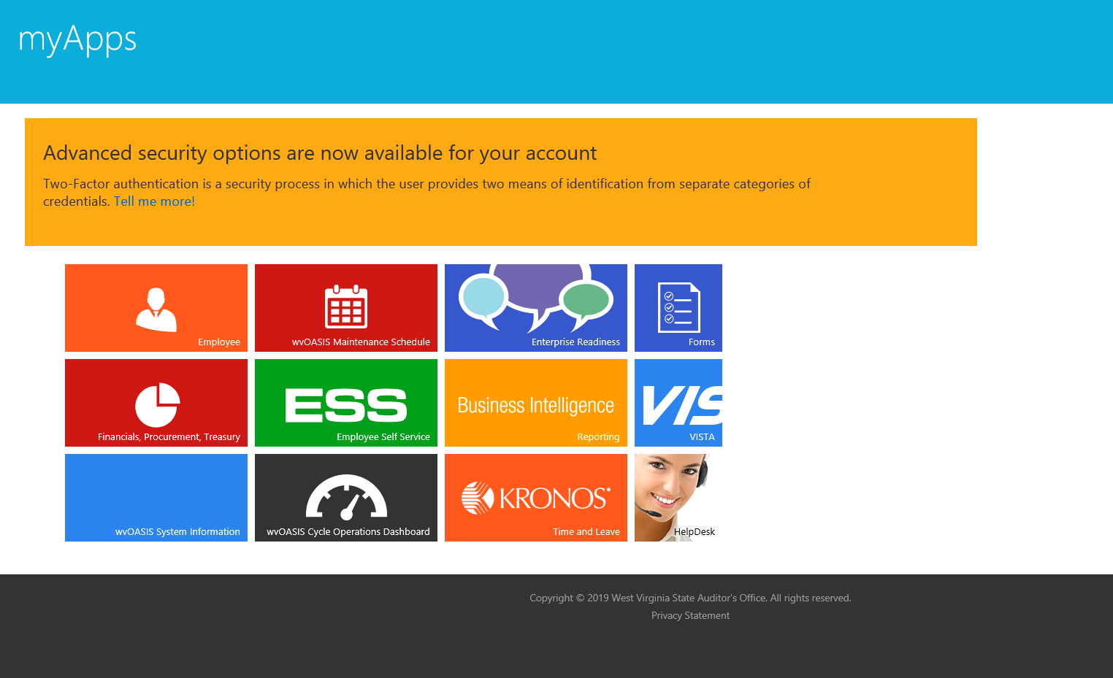
FLEET MANAGEMENT DIVISION
How to get to the wvOASIS reports
https://myapps.wvsao.gov/apps/portal/Default.aspx

Slide 20
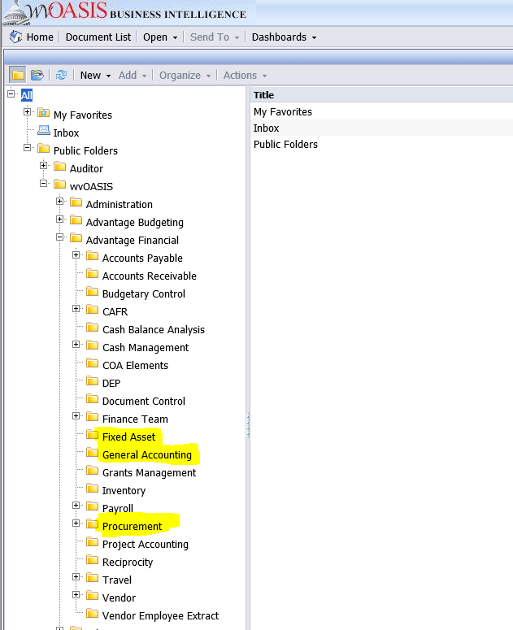
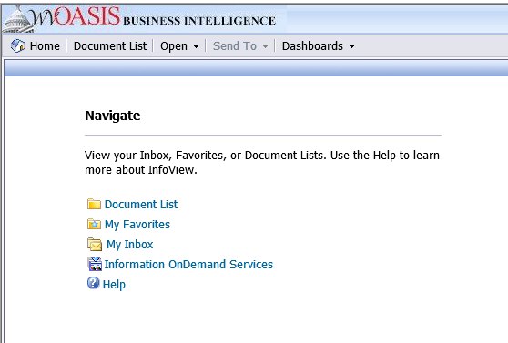
FLEET MANAGEMENT DIVISION
How to get to the wvOASIS reports
https://myapps.wvsao.gov/apps/portal/Default.aspx

Slide 21
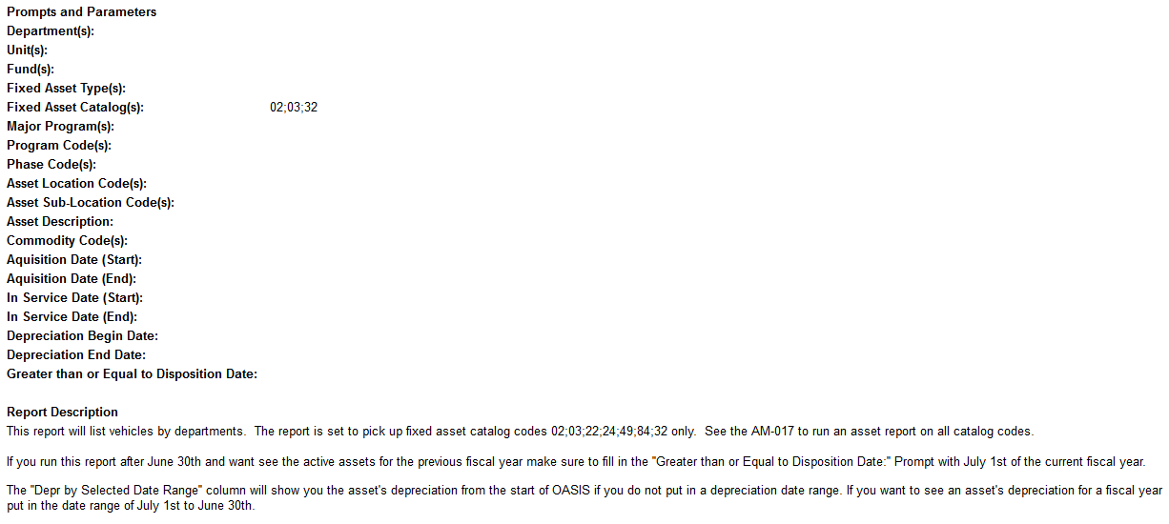
FLEET MANAGEMENT DIVISION
wvOASIS Business Intelligence, Fleet Related Reports
WV-FIN-AM-017V Vehicles by Department

Slide 22
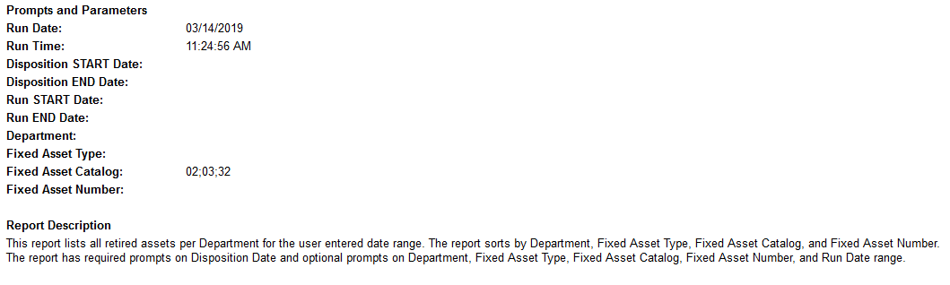
FLEET MANAGEMENT DIVISION
wvOASIS Business Intelligence, Fleet Related Reports
WV-FIN-AM-006 Assets Retired

Slide 23
FLEET MANAGEMENT DIVISION
wvOASIS Business Intelligence, Fleet Related Reports
WV-FIN-PROC-055 Vehicle Agreement Report

Slide 24
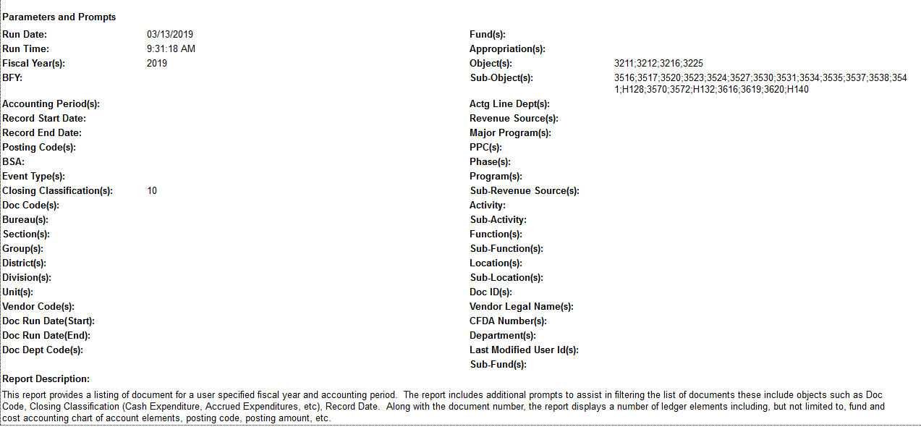
FLEET MANAGEMENT DIVISION
wvOASIS Business Intelligence, Fleet Related Reports
WV-FIN-GL-146 Document Listing

Slide 25
FLEET MANAGEMENT DIVISION
FIMS Object Name | OASIS Object | OASIS Object Name | OASIS Object Definition | OASIS Sub-Obj | OASIS Sub-Obj Name | OASIS Sub Object Definition
TRAVEL | 3211 | TRAVEL EMPLOYEE | Payments for authorized in-state and out-of-state travel expenses for persons who must travel as part of their job function/or position in accordance with the State Travel Regulations as issued by the Travel Management Office, Division of Purchasing, Department of Administration and other approved travel plans. This object code is applicable to state employees, board members, commission members, consultants, contractors, and students, patients, and inmates of state schools, hospitals and institutions. Includes athletic travel, team and associated individual travel, student recruiting expenses, and passports. | 3516 | IN STATE CAR RENTAL | Costs associated with in state travel for car rental fees by a state employee or offical conducting offical state business .
TRAVEL | 3211 | TRAVEL EMPLOYEE | Payments for authorized in-state and out-of-state travel expenses for persons who must travel as part of their job function/or position in accordance with the State Travel Regulations as issued by the Travel Management Office, Division of Purchasing, Department of Administration and other approved travel plans. This object code is applicable to state employees, board members, commission members, consultants, contractors, and students, patients, and inmates of state schools, hospitals and institutions. Includes athletic travel, team and associated individual travel, student recruiting expenses, and passports. | 3517 | IN STATE GASOLINE RENTAL | Costs associated with in state travel for car rental gasoline fees by a state employee or offical conducting offical state business .
TRAVEL | 3211 | TRAVEL EMPLOYEE | Payments for authorized in-state and out-of-state travel expenses for persons who must travel as part of their job function/or position in accordance with the State Travel Regulations as issued by the Travel Management Office, Division of Purchasing, Department of Administration and other approved travel plans. This object code is applicable to state employees, board members, commission members, consultants, contractors, and students, patients, and inmates of state schools, hospitals and institutions. Includes athletic travel, team and associated individual travel, student recruiting expenses, and passports. | 3520 | IN STATE MILEAGE | Costs associated with in state travel for mileage reimbursements for a state employee or offical conducting offical state business.
TRAVEL | 3211 | TRAVEL EMPLOYEE | Payments for authorized in-state and out-of-state travel expenses for persons who must travel as part of their job function/or position in accordance with the State Travel Regulations as issued by the Travel Management Office, Division of Purchasing, Department of Administration and other approved travel plans. This object code is applicable to state employees, board members, commission members, consultants, contractors, and students, patients, and inmates of state schools, hospitals and institutions. Includes athletic travel, team and associated individual travel, student recruiting expenses, and passports. | 3523 | OUT OF STATE CAR RENTAL | Costs associated with out of state travel for car rental fees by a state employee or offical conducting offical state business.
TRAVEL | 3211 | TRAVEL EMPLOYEE | Payments for authorized in-state and out-of-state travel expenses for persons who must travel as part of their job function/or position in accordance with the State Travel Regulations as issued by the Travel Management Office, Division of Purchasing, Department of Administration and other approved travel plans. This object code is applicable to state employees, board members, commission members, consultants, contractors, and students, patients, and inmates of state schools, hospitals and institutions. Includes athletic travel, team and associated individual travel, student recruiting expenses, and passports. | 3524 | OUT OF STATE GASOLINE RENTAL | Costs associated with out of state travel for car rental gasoline fees by a state employee or offical conducting offical state business.
TRAVEL | 3211 | TRAVEL EMPLOYEE | Payments for authorized in-state and out-of-state travel expenses for persons who must travel as part of their job function/or position in accordance with the State Travel Regulations as issued by the Travel Management Office, Division of Purchasing, Department of Administration and other approved travel plans. This object code is applicable to state employees, board members, commission members, consultants, contractors, and students, patients, and inmates of state schools, hospitals and institutions. Includes athletic travel, team and associated individual travel, student recruiting expenses, and passports. | 3527 | OUT OF STATE MILEAGE | Costs associated with out of state travel for mileage reimbursements for a state employee or offical conducting offical state business.

Slide 26
FLEET MANAGEMENT DIVISION
FIMS Object Name | OASIS Object | OASIS Object Name | OASIS Object Definition | OASIS Sub-Obj | OASIS Sub-Obj Name | OASIS Sub Object Definition
TRAVEL | 3212 | TRAVEL NON EMPLOYEE | Payments for authorized in-state and out-of-state travel expenses for persons who must travel as part of their job function/or position in accordance with the State Travel Regulations as issued by the Travel Management Office, Division of Purchasing, Department of Administration and other approved travel plans. This object code is applicable to state employees, board members, commission members, consultants, contractors, and students, patients, and inmates of state schools, hospitals and institutions. Includes athletic travel, team and associated individual travel, student recruiting expenses, and passports. | 3530 | IN STATE CAR RENTAL | Costs associated with a vehicle rental by a board member, commission member,consultant, contractor for authorized in state travel.
TRAVEL | 3212 | TRAVEL NON EMPLOYEE | Payments for authorized in-state and out-of-state travel expenses for persons who must travel as part of their job function/or position in accordance with the State Travel Regulations as issued by the Travel Management Office, Division of Purchasing, Department of Administration and other approved travel plans. This object code is applicable to state employees, board members, commission members, consultants, contractors, and students, patients, and inmates of state schools, hospitals and institutions. Includes athletic travel, team and associated individual travel, student recruiting expenses, and passports. | 3531 | IN STATE GASOLINE RENTAL | Costs associated with vehicle rental gasoline expense by a board member, commission member,consultant, contractor for authorized in state travel.
TRAVEL | 3212 | TRAVEL NON EMPLOYEE | Payments for authorized in-state and out-of-state travel expenses for persons who must travel as part of their job function/or position in accordance with the State Travel Regulations as issued by the Travel Management Office, Division of Purchasing, Department of Administration and other approved travel plans. This object code is applicable to state employees, board members, commission members, consultants, contractors, and students, patients, and inmates of state schools, hospitals and institutions. Includes athletic travel, team and associated individual travel, student recruiting expenses, and passports. | 3534 | IN STATE MILEAGE | Costs associated with mileage reimbursements by a board member, commission member,consultant, contractor for authorized in state travel.
TRAVEL | 3212 | TRAVEL NON EMPLOYEE | Payments for authorized in-state and out-of-state travel expenses for persons who must travel as part of their job function/or position in accordance with the State Travel Regulations as issued by the Travel Management Office, Division of Purchasing, Department of Administration and other approved travel plans. This object code is applicable to state employees, board members, commission members, consultants, contractors, and students, patients, and inmates of state schools, hospitals and institutions. Includes athletic travel, team and associated individual travel, student recruiting expenses, and passports. | 3535 | IN STATE MISC | Costs associated with covered miscellaneous reimbursements by a board member, commission member,consultant, contractor for authorized in state travel.
TRAVEL | 3212 | TRAVEL NON EMPLOYEE | Payments for authorized in-state and out-of-state travel expenses for persons who must travel as part of their job function/or position in accordance with the State Travel Regulations as issued by the Travel Management Office, Division of Purchasing, Department of Administration and other approved travel plans. This object code is applicable to state employees, board members, commission members, consultants, contractors, and students, patients, and inmates of state schools, hospitals and institutions. Includes athletic travel, team and associated individual travel, student recruiting expenses, and passports. | 3537 | OUT OF STATE CAR RENTAL | Costs associated with a vehicle rental by a board member, commission member,consultant, contractor for authorized out of state travel.
TRAVEL | 3212 | TRAVEL NON EMPLOYEE | Payments for authorized in-state and out-of-state travel expenses for persons who must travel as part of their job function/or position in accordance with the State Travel Regulations as issued by the Travel Management Office, Division of Purchasing, Department of Administration and other approved travel plans. This object code is applicable to state employees, board members, commission members, consultants, contractors, and students, patients, and inmates of state schools, hospitals and institutions. Includes athletic travel, team and associated individual travel, student recruiting expenses, and passports. | 3538 | OUT OF STATE GASOLINE RENTAL | Costs associated with vehicle rental gasoline expense by a board member, commission for authorized out of state travel.

Slide 27
FLEET MANAGEMENT DIVISION
FIMS Object Name | OASIS Object | OASIS Object Name | OASIS Object Definition | OASIS Sub-Obj | OASIS Sub-Obj Name | OASIS Sub Object Definition
TRAVEL | 3212 | TRAVEL NON EMPLOYEE | Payments for authorized in-state and out-of-state travel expenses for persons who must travel as part of their job function/or position in accordance with the State Travel Regulations as issued by the Travel Management Office, Division of Purchasing, Department of Administration and other approved travel plans. This object code is applicable to state employees, board members, commission members, consultants, contractors, and students, patients, and inmates of state schools, hospitals and institutions. Includes athletic travel, team and associated individual travel, student recruiting expenses, and passports. | 3541 | OUT OF STATE MILEAGE | Costs associated with mileage reimbursements by a board member, commission member,consultant, contractor for authorized out of state travel.
TRAVEL | 3212 | TRAVEL NON EMPLOYEE | Payments for authorized in-state and out-of-state travel expenses for persons who must travel as part of their job function/or position in accordance with the State Travel Regulations as issued by the Travel Management Office, Division of Purchasing, Department of Administration and other approved travel plans. This object code is applicable to state employees, board members, commission members, consultants, contractors, and students, patients, and inmates of state schools, hospitals and institutions. Includes athletic travel, team and associated individual travel, student recruiting expenses, and passports. | H128 | TRAVEL NON EMPLOYEE | Default (Higher Ed ONLY)
VEHICLE RENTAL | 3216 | VEHICLE RENTAL | Auto, aircraft (i.e., fixed wing and helicopter), farm equipment (off road) rental, earth moving, hauling, and DOH emergencies for snow/flood. Should not include travel related vehicle rentals, instead use the appropriate codes under 3211 or 3212. | 3570 | LEASED VEHICLES | Vehicle lease payments made to an outside agency such as Enterprise.
VEHICLE RENTAL | 3216 | VEHICLE RENTAL | Auto, aircraft (i.e., fixed wing and helicopter), farm equipment (off road) rental, earth moving, hauling, and DOH emergencies for snow/flood. Should not include travel related vehicle rentals, instead use the appropriate codes under 3211 or 3212. | 3572 | RENTAL VEHICLES | Fees paid for vehicle rentals.
VEHICLE RENTAL | 3216 | VEHICLE RENTAL | Auto, aircraft (i.e., fixed wing and helicopter), farm equipment (off road) rental, earth moving, hauling, and DOH emergencies for snow/flood. Should not include travel related vehicle rentals, instead use the appropriate codes under 3211 or 3212. | H132 | VEHICLE RENTAL | Default (Higher Ed ONLY)
VEHICLE OPERATING EXP | 3225 | VEHICLE OPERATING EXP | For vehicle operating expenses, including helicopter and fixed wing aircraft. Oil, grease, car washes, minor maintenance repairs such as headlight replacement, tire repair, wheel alignment, windshield wipers, etc. | 3616 | FLEET VEHICLE EXPENSE | Minor repair services made on state owned Fleet Vehicles.

Slide 28
FLEET MANAGEMENT DIVISION
FIMS Object Name | OASIS Object | OASIS Object Name | OASIS Object Definition | OASIS Sub-Obj | OASIS Sub-Obj Name | OASIS Sub Object Definition
VEHICLE OPERATING EXP | 3225 | VEHICLE OPERATING EXP | For vehicle operating expenses, including helicopter and fixed wing aircraft. Oil, grease, car washes, minor maintenance repairs such as headlight replacement, tire repair, wheel alignment, windshield wipers, etc. | 3619 | TIRES | Maintenance expense to replace tires on state owned vehicles.
VEHICLE OPERATING EXP | 3225 | VEHICLE OPERATING EXP | For vehicle operating expenses, including helicopter and fixed wing aircraft. Oil, grease, car washes, minor maintenance repairs such as headlight replacement, tire repair, wheel alignment, windshield wipers, etc. | 3620 | TOWING | Towing cost for a state owned vehicle.
VEHICLE OPERATING EXP | 3225 | VEHICLE OPERATING EXP | For vehicle operating expenses, including helicopter and fixed wing aircraft. Oil, grease, car washes, minor maintenance repairs such as headlight replacement, tire repair, wheel alignment, windshield wipers, etc. | H140 | VEHICLE OPERATING EXP | Default (Higher Ed ONLY)

Slide 29
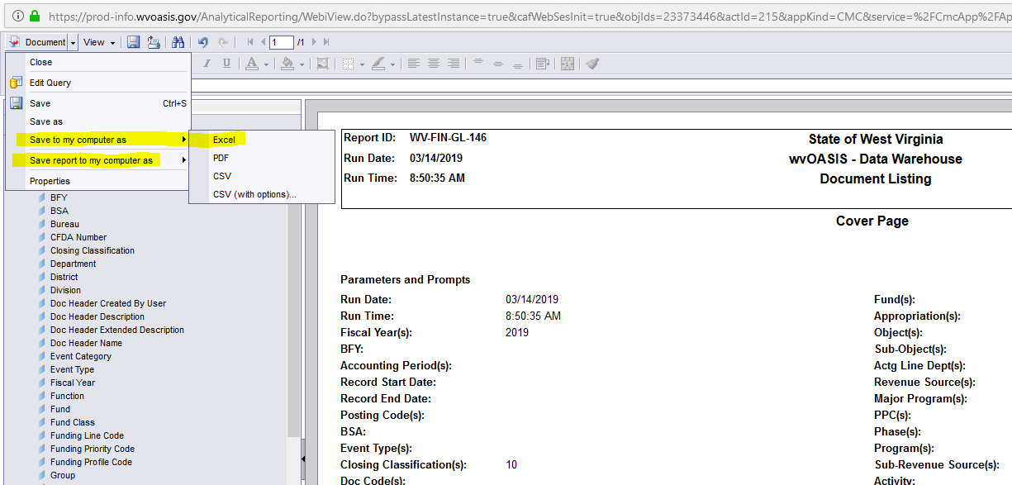
FLEET MANAGEMENT DIVISION
wvOASIS Business Intelligence, Fleet Related Reports – Saving as Excel file

Slide 30
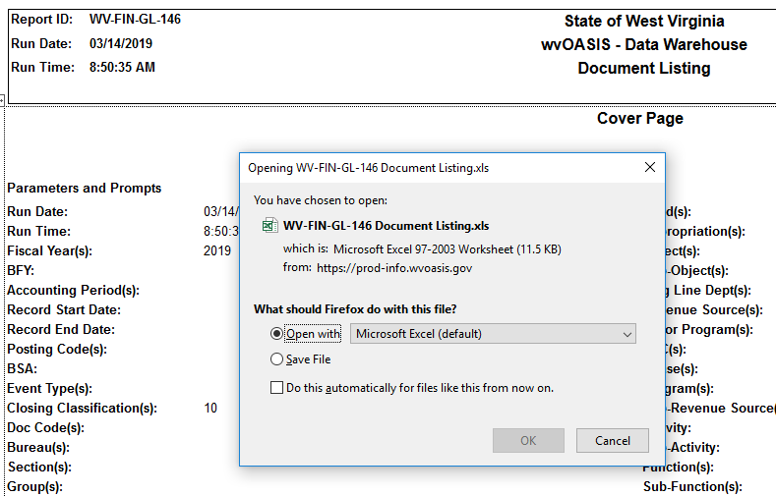
FLEET MANAGEMENT DIVISION
wvOASIS Business Intelligence, Fleet Related Reports – Saving as Excel file

Slide 31
FLEET MANAGEMENT DIVISION
FMD has negotiated a contract with ARI to perform the following for each participating State vehicle:
  24x7x365 access to a team of ASE-certified car and truck technicians who scrutinize repair requests and negotiate with vendors for best prices
  A simple prompt at the beginning of each call makes sure calls are routed to technicians experience with your type of vehicles
  Access to an open vendor network comprised of 90,000 shops, including national accounts that offer up to 20% off of retail prices

Slide 32
FLEET MANAGEMENT DIVISION
FMD has negotiated a contract with ARI to perform the following for each participating State vehicle:
  Preventative maintenance schedules that are customized to the types of vehicles in your fleet
  Ability to see exactly where your maintenance dollars are going
  One monthly invoice, available on-line, for all vehicle maintenance issues.
  Vehicle Recall Tracking
  Vehicle PO Tracking
  Variety of Reporting functions

Slide 33
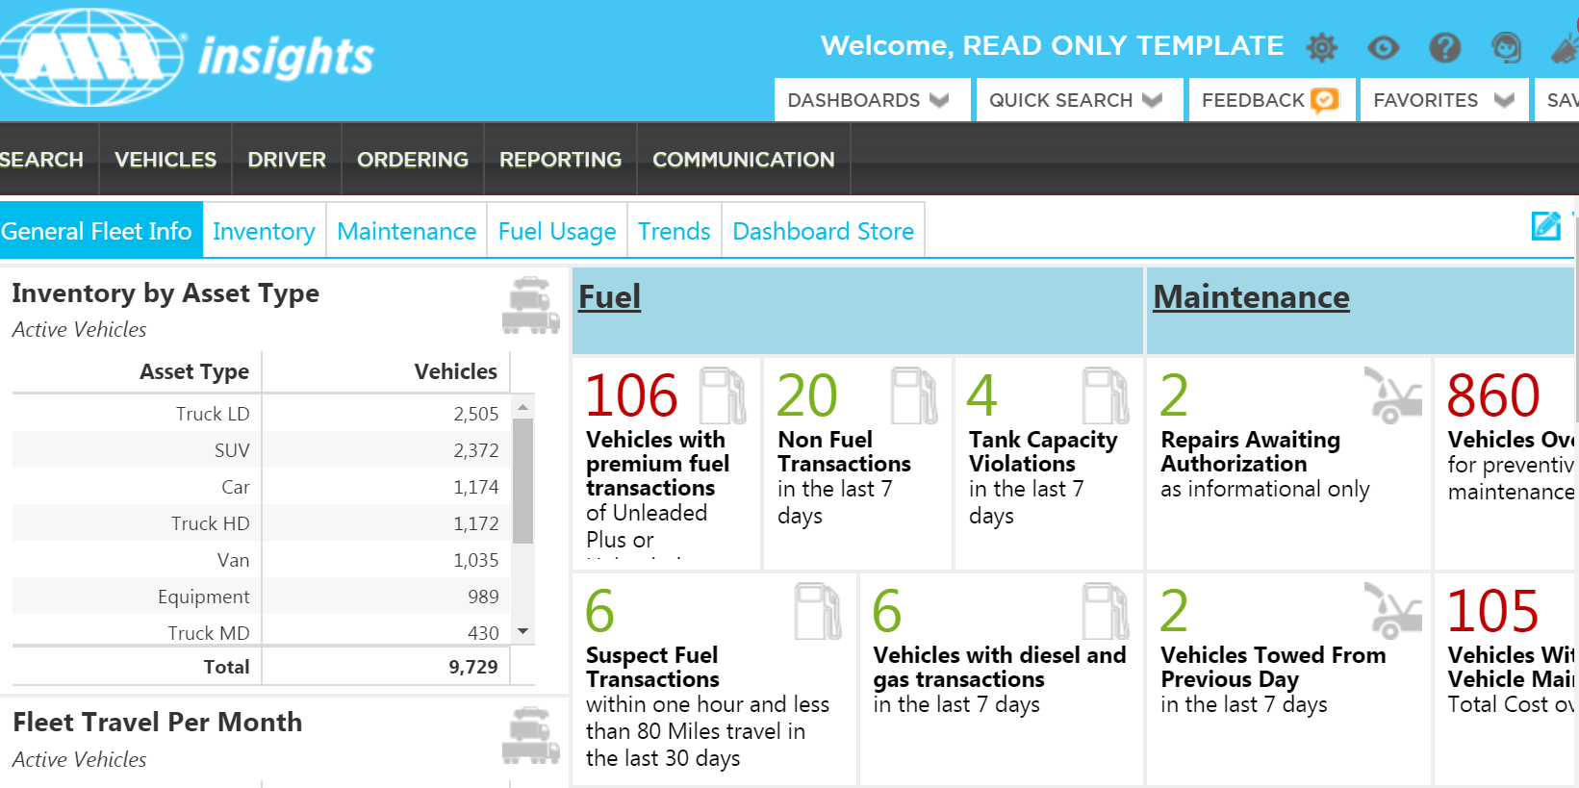
MANAGING THE ASSET - MAINTENANCE

Slide 34
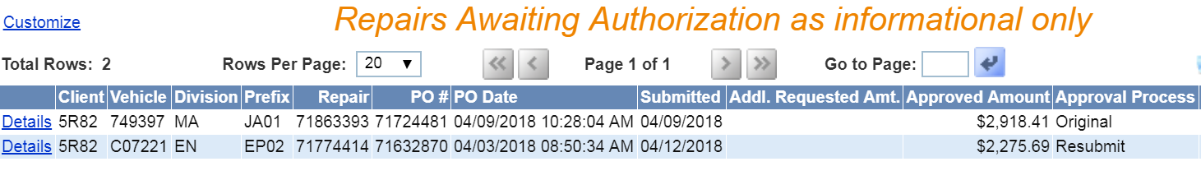
MANAGING THE ASSET - MAINTENANCE
This Repairs Awaiting Authorization screen will show you the vehicles and the $ amounts awaiting approval.
Click on the Details link beside of the vehicle and you will get further down into that specific vehicle.

Slide 35
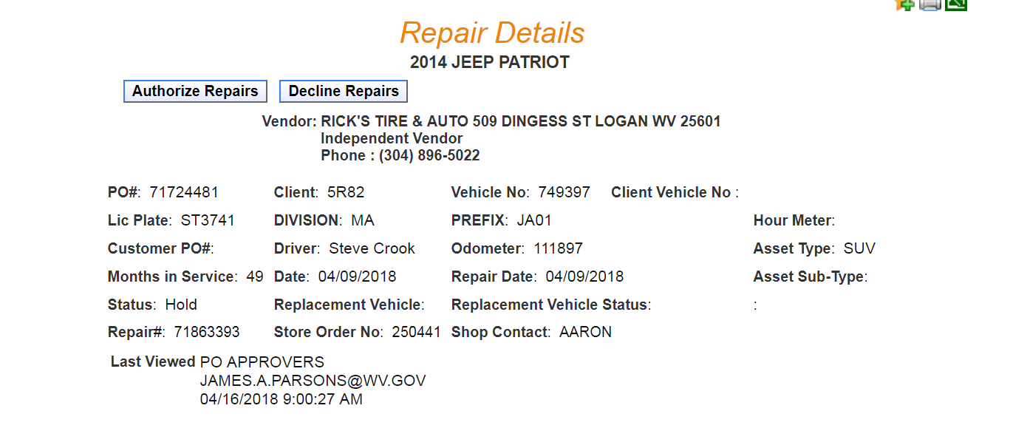
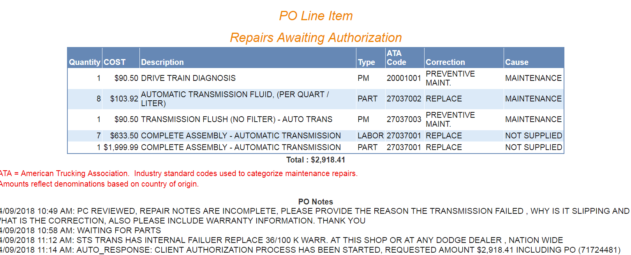
MANAGING THE ASSET - MAINTENANCE

Slide 36
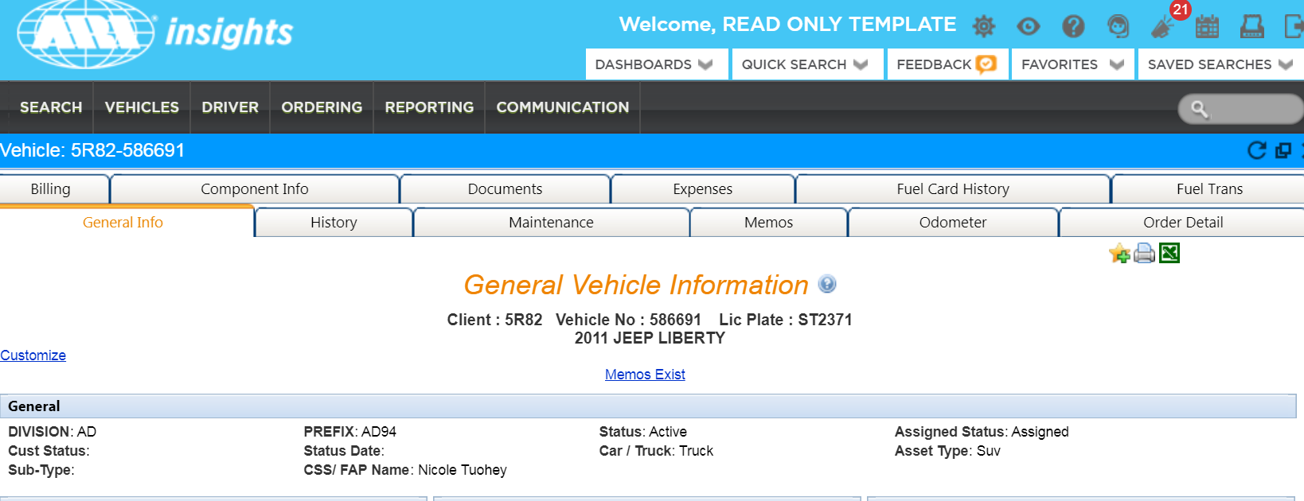
MANAGING THE ASSET - MAINTENANCE
123456
123456

Slide 37
MANAGING THE ASSET - FUELING
ARI FUEL provides:
  ARI branded WEX fueling card
    WEX platform that the state has been using for several years
  A Fuel-Only Credit Card that is accepted universally
    Locks down the purchase to the commodity
      Reduces the states exposer to risk and the labor to ensure purchases are for fueling a state vehicle
  Transactional details for better auditing.
  Fuel purchase restrictions to minimize fraud.
  Fast reporting of compromised cards.

Slide 38
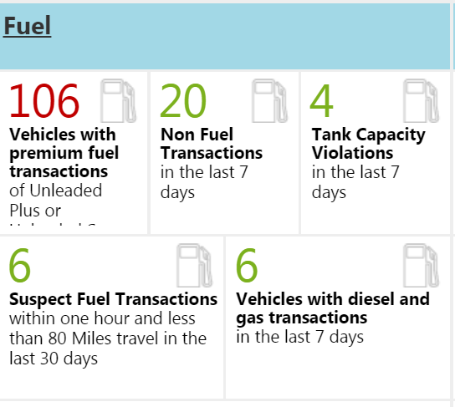
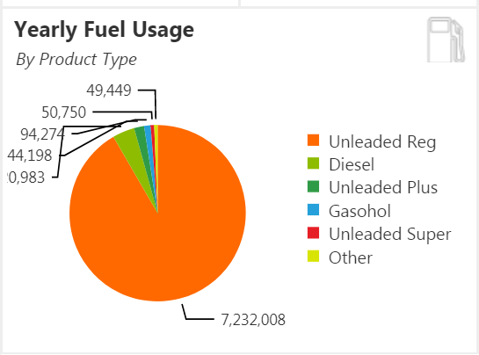
MANAGING THE ASSET - FUELING

Slide 39
MANAGING THE ASSET - FUELING
These alerts are very important to the management of your fleets fuel program.
The Vehicles with premium fuel transactions alerts is the first alert to review.
All vehicles are to purchase regular Unleaded fuel unless otherwise specified by the vehicle manufacturer.
By clicking on the number 106, you are directed to a detail screen of the vehicles who purchased premium fuel.

Slide 40
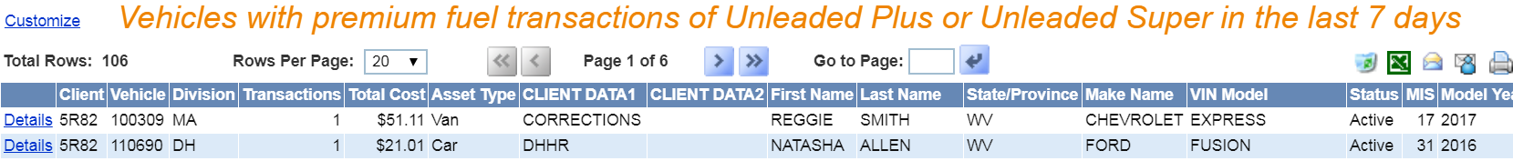
MANAGING THE ASSET - FUELING

Slide 41
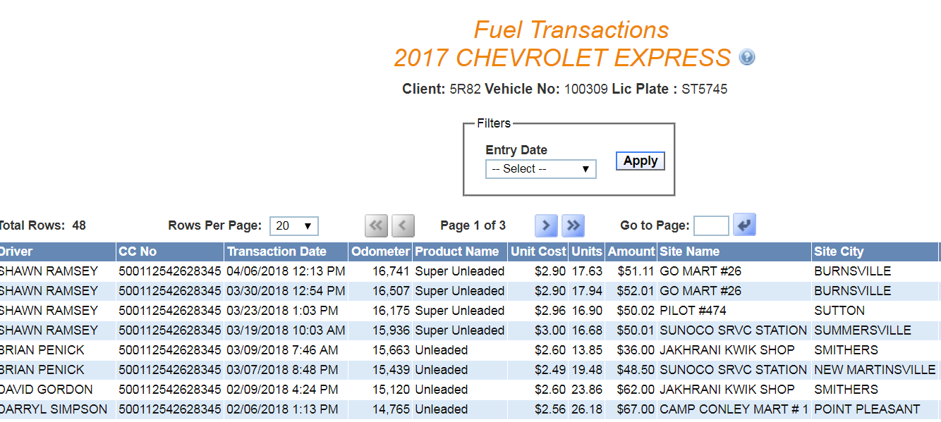
MANAGING THE ASSET - FUELING

Slide 42
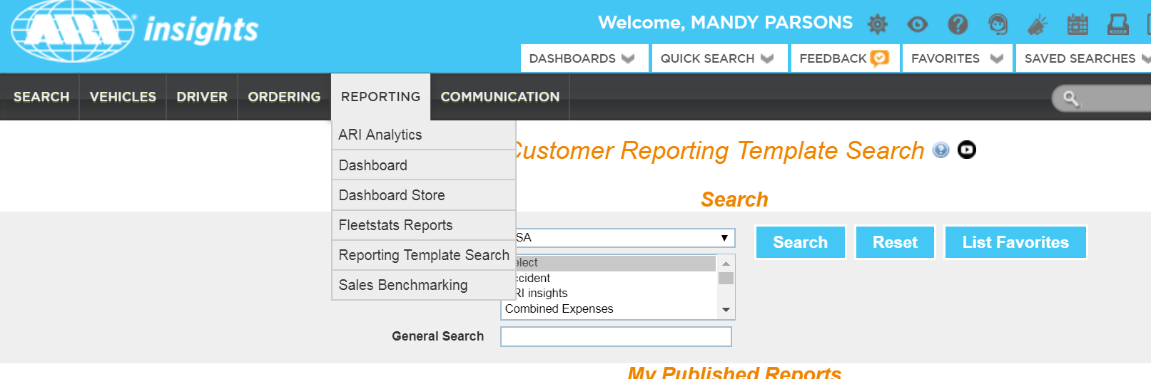
FLEET MANAGEMENT DIVISION
ARI has a large selection of standard reports at your fingertips.

Slide 43
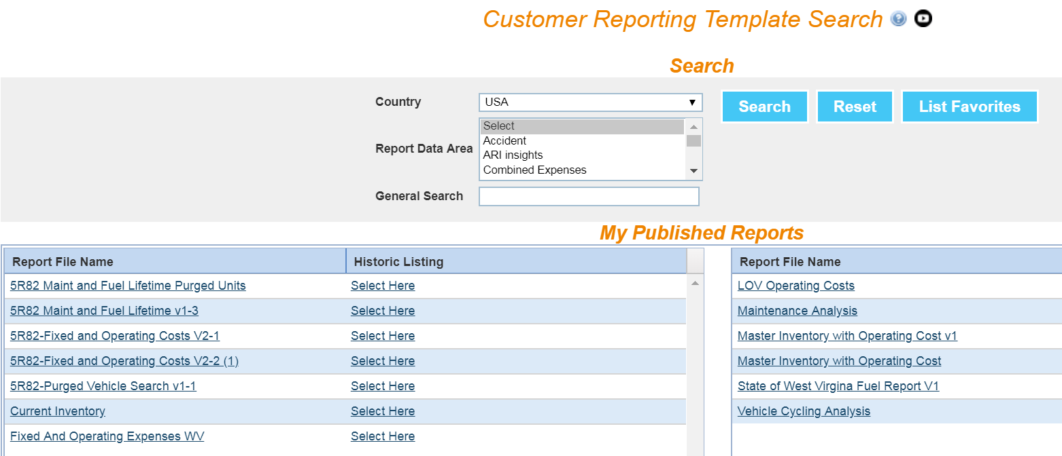
FLEET MANAGEMENT DIVISION
USEFUL REPORTS LISTED IN THE PUBLISHED REPORTS SECTION:

Slide 44
FLEET MANAGEMENT DIVISION
LOV Operating Costs report (Life of Vehicle)

Slide 45
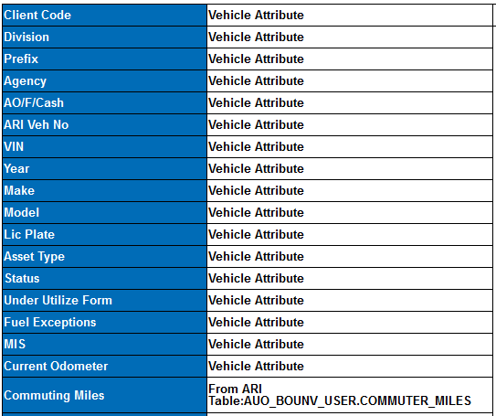
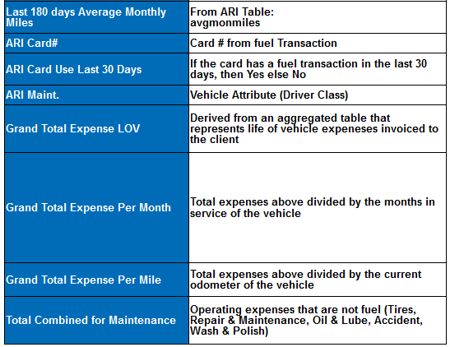
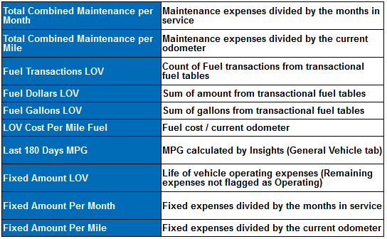
FLEET MANAGEMENT DIVISION
LOV Operating Costs report (Life of Vehicle)

Slide 46
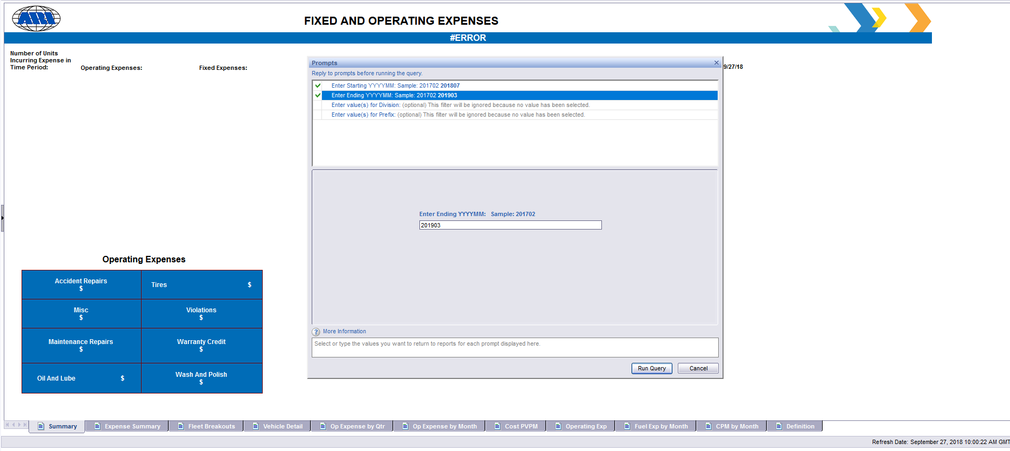
FLEET MANAGEMENT DIVISION
Fixed and Operating Expenses

Slide 47
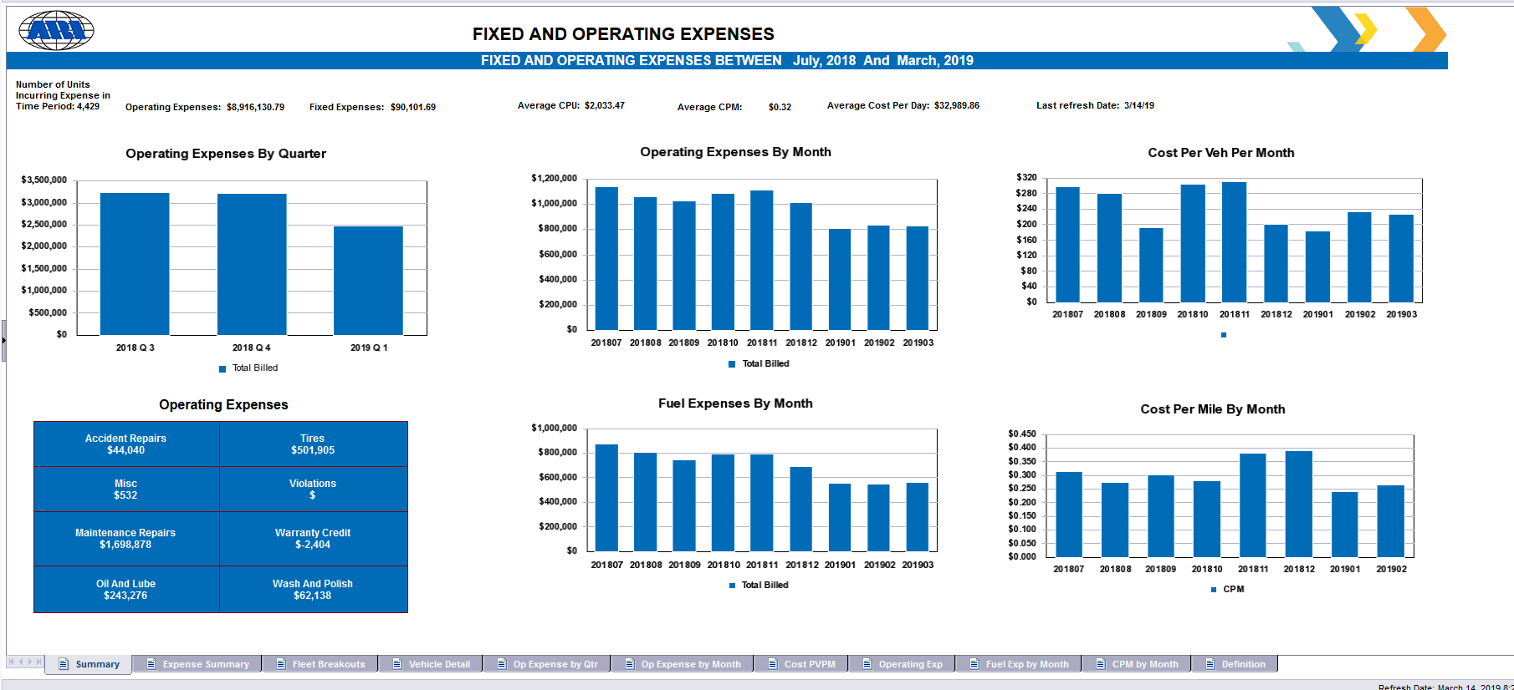
FLEET MANAGEMENT DIVISION
Fixed and Operating Expenses

Slide 48
ARI Customer Reporting Template Search
ARI Reports
Report Name | Description | Data Area
ACTIVE SNAPSHOT IN TIME | Returns the vehicles that were active on a given day and includes their current status. Based on a vehicle's delivery date and sold date. | Inventory
ACTIVE VENDOR BY STATE/PROVINCE | Vendor lookup by State/Prov.. Returns active vendors used within the state/prov.(s) entered in prompt. | Maintenance
ACTIVE VENDOR BY STATE/PROVINCE-US | Returns vendors based on State & groups by City | Maintenance
B AND M INVOICE BILLING | B and M Invoice by Expense Category Summaries by: Division Prefix Detail by: Vehicle | Combined Expenses
FIELD ADJUSTMENT SAVINGS | Returns savings for field adjustments, post warranty by year and month within the date range you enter. Also includes all detail by vehicle and line item. | Maintenance
FIXED AND OPERATING EXPENSES | Expense Groups by Fixed and Operating breakouts. Division and Prefix reports | Combined Expenses
FUEL AND TANK EXCEPTION-WEX | Exception reporting for: Tank Capacity Violation Premium Fuel Purchase Mis-Matched Fuel Types Non-Fuel Purchase Multiple Transactions in a day | Fuel
FUEL PROGRAM UTILIZATION | Fuel Program Utilization: Number of vehicles on Program vs. number of vehicle using program. | Fuel
FUEL REPORT | Transactions, Co2, Expense by fuel type, cost per Gallon, CPG/month, Drivers and PINs, Month and Quarter | Fuel
FUEL STATISTICS AND MPG | Counts by client, division, asset type. Usage by client, division, asset type. MPG by asset type. | Fuel
INSURANCE CLAIM REPORT | Insurance claims with claim detail and po detail. Breakouts by Accident Type, Driver Type. | Accident
LEASE PROJECTIONS - FULL AMORTIZATION SCHEDULE ISS | Full Schedule for Lease amortization Not by calendar month. Listing is for each month of the lease schedule. Covers Plateau, Level Pay and Closed End leases. | Lease
LEASE PROJECTIONS - MONTHLY AMORTIZATION SCHEDULE ISS | Monthly Schedule for Lease amortization. Listing is for each month of the lease schedule going forward. Covers Plateau, Level Pay and Closed End leases. | Inventory,Lease
M INVOICE AND MAINTENANCE EXPENSES | Maintenance and Invoice details | Maintenance
MAINTENANCE PROGRAM AND PM COMPLIANCE | Maintenance and program utilization with PM compliance. | Maintenance
MILES BY MONTH IN A DATE RANGE | Monthly mileage by vehicle between date range entered | Mileage and Odometer
MPG AND MILES USING FIRST AND LAST ODOMETER | Mileage and MPG related | Mileage and Odometer
NEW VEHICLE ORDER STATUS INCLUDING DELIVERING DEALER INFORMATION US-CA | New Vehicle Order Status with additional attributes for Delivering Dealer | Ordering
PIN REPORT AND LAST PIN TRANSACTION | PIN transaction and last use date | Fuel
PM RELATED POS | PM related Purchase Orders. Breakouts for Independent and National account Types Avg Cost per PM | Maintenance
PO COST ANALYSIS | Based on PO Creation Date, returns top 10 ATA expense categories by month or by quarter. Includes PO statistics such as avg mileage, avg vehicle age, # of PO's issued, avg $ of PO's issued. Also includes ranking of top 10 vehicle types incurring expenses. Prompt for client code(s), Division, Prefix and PO date range. | Maintenance
PREVENTIVE MAINTENANCE DATES | Maintenance program utilization and overdue PM | Maintenance
SAVINGS ACTIVITY MASTER | The report returns savings for field adjustments, post warranty and subrogation by year and by quarter within the date range you enter. Also includes all detail by vehicle and line item. | Maintenance
TRIP LOG MOBILE APP AND WEB | Mileage reporting via Web or App entry. Daily, weekly and by driver. | Mileage and Odometer
VEHICLE ORDER STATUS-FACTORY ORDERS | Ordered vehicles and where in the process they are. Ordered, produced, upfitting, delivered for ship thru order types. | Ordering
VENDOR ANALYSIS | Vendor usage by Independent vs. National Account | Maintenance
VIOLATIONS | Returns detail for violations entered into ARI's system during the date range you request. Also provides additional summary tabs by Violation State, Violation Type, Division, & Prefix. Details include driver name, violation #, violation amount, ARI paid amount, ARI fee, Adjudication fee, violation date, type and location. | Violations
VIOLATIONS | Returns detail for violations entered into ARI's system during the date range you request. Also provides additional summary tabs by Violation State, Violation Type, Division, & Prefix. Details include driver name, violation #, violation amount, ARI paid amount, ARI fee, Adjudication fee, violation date, type and location. | Violations

Slide 49

QUESTIONS

Slide 50
FLEET MANAGEMENT DIVISION
  FMD Web Site:
  www.fleet.wv.gov
  Phone # 855-817-1910
  ARI Maintenance:
  https://ariinsights.arifleet.com
  1-800-CAR-CARE (800-227-2273)
  ARI Fuel:
  https://ariinsights.arifleet.com
  1-800-505-4939 (Problems at the Pump)

Slide 51
2018 State's Mainenance Benchmarks Based of Life of Vehicle Operating Cost
Category | State # of Units as of 3/9/2018 | Average of MIS | Average of Current Odometer | Average of Grand Total Expense LOV | Average of Total Combined for Maintenance | Average of Fuel Dollars LOV | Average of LOV Cost Per Mile Fuel | Average of Last 180 Days MPG
BUS 2002-Older | 2 | 214 | 22320 | $1,350.58 | $665.30 | $537.53 | $0.03 | 0
CAR 2006-OLDER | 5 | 178 | 120929 | $10,815.58 | $4,442.15 | $5,924.58 | $0.06 | 17
CAR 2007-2008 | 34 | 122 | 95180 | $11,934.73 | $5,225.40 | $6,757.63 | $0.07 | 24
CAR 2009-2010 | 62 | 103 | 105119 | $10,689.76 | $3,472.57 | $6,896.58 | $0.07 | 27
CAR 2011-2012 | 91 | 77 | 78720 | $8,442.57 | $2,610.37 | $5,602.69 | $0.07 | 28
CAR 2013-2014 | 92 | 53 | 64151 | $7,055.18 | $1,844.52 | $5,063.83 | $0.08 | 29
CAR 2015-2016 | 90 | 32 | 48927 | $5,886.45 | $1,146.96 | $4,613.86 | $0.10 | 26
CAR 2017 | 50 | 19 | 38312 | $3,848.03 | $719.86 | $3,040.59 | $0.08 | 29
Motorcycle 2013-OLDER | 3 | 70 | 4113 | $762.06 | $190.27 | $340.59 | $0.08 | 36
SUV 2006- ODER | 21 | 179 | 121244 | $18,201.70 | $7,443.17 | $10,195.58 | $0.10 | 13
SUV 2007-2008 | 50 | 125 | 111431 | $20,020.33 | $6,779.20 | $12,731.79 | $0.12 | 17
SUV 2009-2010 | 73 | 101 | 98615 | $16,833.49 | $5,597.37 | $10,905.76 | $0.12 | 18
SUV 2011-2012 | 188 | 78 | 95655 | $15,539.67 | $4,699.71 | $10,543.24 | $0.11 | 19
SUV 2013-2014 | 322 | 56 | 85020 | $12,925.06 | $3,571.77 | $9,173.81 | $0.11 | 20
SUV 2015-2016 | 245 | 29 | 47547 | $6,680.91 | $1,172.58 | $5,397.84 | $0.12 | 20
SUV 2017-2018 | 47 | 8 | 10776 | $1,453.97 | $314.10 | $1,270.68 | $0.11 | 26
TRUCK HD 2006-OLDER | 6 | 297 | 185859 | $18,253.69 | $10,967.32 | $9,622.94 | $0.07 | 6
TRUCK HD 2007-2008 | 2 | 128 | 16265 | $19,590.82 | $12,555.86 | $6,617.06 | $0.42 | 4
TRUCK HD 2009-2010 | 2 | 98 | 83473 | $5,096.41 | $4,786.28 | $147.76 | $0.00 | 0
TRUCK HD 2011-2012 | 0 | 0 | 0 | $0.00 | $0.00 | $0.00 | $0.00 | 0
TRUCK HD 2013-2014 | 1 | 42 | 36072 | $30,281.54 | $7,715.60 | $22,235.72 | $0.62 | 5
TRUCK HD 2015-2016 | 6 | 41 | 28429 | $14,350.97 | $3,266.81 | $10,922.66 | $0.35 | 13
TRUCK HD 2017-2018 | 3 | 16 | 9534 | $2,520.27 | $483.44 | $1,976.58 | $0.19 | 8
TRUCK LD 2006-OLDER | 32 | 234 | 77864 | $11,892.33 | $5,609.96 | $6,041.72 | $0.09 | 0
TRUCK LD 2007-2008 | 47 | 128 | 98295 | $21,538.49 | $7,356.19 | $13,923.27 | $0.14 | 12
TRUCK LD 2009-2010 | 54 | 103 | 104521 | $21,739.56 | $6,080.93 | $15,334.19 | $0.15 | 14
TRUCK LD 2011-2012 | 137 | 77 | 98544 | $18,677.96 | $4,709.58 | $13,686.67 | $0.14 | 14
TRUCK LD 2013-2014 | 114 | 51 | 70538 | $14,077.19 | $2,922.82 | $10,975.92 | $0.16 | 14
TRUCK LD 2015-2016 | 183 | 31 | 43290 | $9,587.17 | $1,386.71 | $8,105.35 | $0.19 | 13
TRUCK LD 2017-2018 | 10 | 9 | 11173 | $2,254.42 | $246.33 | $2,044.29 | $0.18 | 14
TRUCK MD 2006-OLDER | 11 | 212 | 134433 | $23,379.55 | $16,597.78 | $9,293.74 | $0.09 | 0
TRUCK MD 2007-2008 | 9 | 127 | 101345 | $13,052.14 | $8,456.46 | $4,976.57 | $0.17 | 10
TRUCK MD 2009-2010 | 2 | 110 | 75848 | $13,564.33 | $5,934.55 | $7,434.59 | $0.10 | 8
TRUCK MD 2011-2012 | 0 | 0 | 0 | $0.00 | $0.00 | $0.00 | $0.00 | 0
TRUCK MD 2013-2014 | 2 | 56 | 137491 | $27,339.47 | $15,227.02 | $11,881.15 | $0.18 | 8
TRUCK MD 2015-2016 | 2 | 29 | 95086 | $26,052.59 | $3,077.17 | $22,844.48 | $0.24 | 10
TRUCK MD 2017-2018 | 2 | 10 | 4978 | $1,357.63 |  | $1,319.13 | $0.25 | 9
VAN 2006-OLDER | 47 | 201 | 89083 | $9,790.59 | $4,598.86 | $4,785.92 | $0.05 | 12
VAN 2007-2008 | 45 | 125 | 102168 | $19,396.56 | $6,370.20 | $12,649.82 | $0.12 | 19
VAN 2009-2010 | 31 | 92 | 80205 | $15,489.54 | $4,059.88 | $11,128.20 | $0.14 | 17
VAN 2011-2012 | 47 | 74 | 71147 | $12,135.73 | $3,013.61 | $8,844.20 | $0.13 | 16
VAN 2013-2014 | 71 | 51 | 71322 | $8,930.32 | $1,967.88 | $6,825.08 | $0.11 | 25
VAN 2015-2016 | 105 | 30 | 40706 | $7,264.31 | $1,090.46 | $6,069.31 | $0.15 | 16
VAN 2017-2018 | 25 | 6 | 10480 | $1,790.88 | $522.43 | $1,552.21 | $0.14 | 15

Slide 52
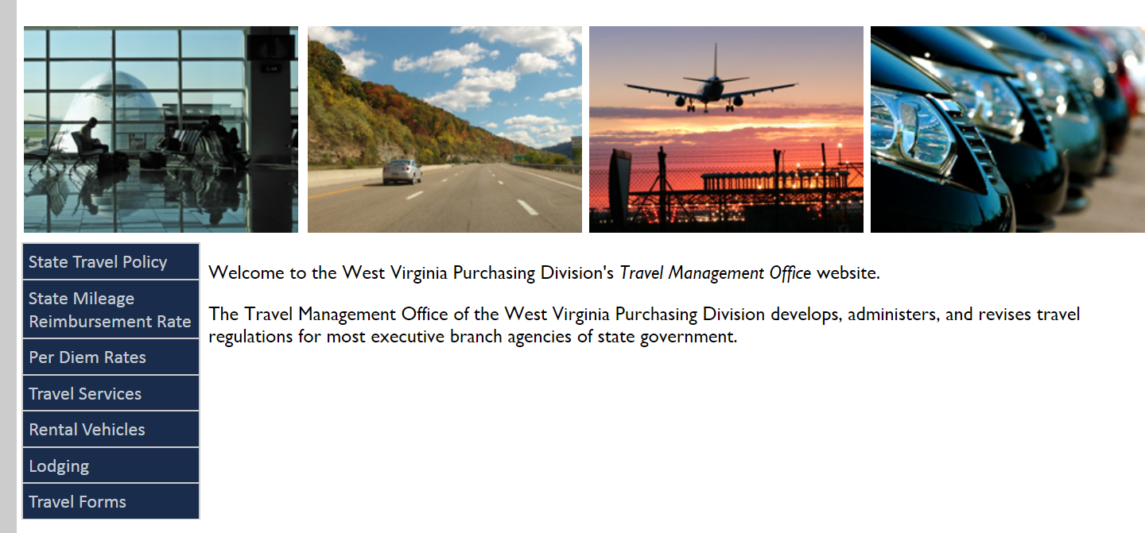
TRAVEL MANAGEMENT OFFICE

Slide 53
WV STATE WIDE CONTRACT for RENTAL VEHICLES
http://www.state.wv.us/admin/purchase/travel/rental.html
Vehicle Data Reference Chart
Hertz Rates
Vehicle Selection | MPGs | Daily | Weekly | Monthly
Compacts (Nissan Versa Note) | 36 MPG | $29.00 | $159.50 | $653.95
Intermediate (Chrysler 200, Corolla) | 33 MPG | $33.00 | $181.50 | $744.15
Fullsize (Altima) | 33 MPG | $36.00 | $198.00 | $811.80
Luxury (MKZ, Impala) | 28 MPG | $84.00 | $462.00 | $1,894.20
Specialty (Jeep, Convertible) | 23 MPG | $84.00 | $462.00 | $1,894.20
Hybrid (Prius Hybrid, Nissan LEAF) | 40 MPG | $42.00 | $231.00 | $947.10
Small SUVs (RAV4, Sante Fe) | 22 MPG | $63.00 | $346.50 | $1,420.65
Large SUVs (Tahoe, Navigator) | 20 MPG | $84.00 | $462.00 | $1,894.20
Small Pick-Up (Nissan Frontier) | 21 MPG | $84.00 | $462.00 | $1,894.20
Trucks (Silverado, Ram 1500 Quad Cab) | 25 MPG | $106.00 | $583.00 | $2,390.30
Minivans (Grand Caravan, Sienna) | 22 MPG | $58.00 | $319.00 | $1,307.90
12-Passenger Van (Ford & Chevys) | 14 MPG | $79.00 | $434.50 | $1,781.45
Vehicle Data Reference Chart
Enterprise/National Rates
Vehicle Selection | MPGs | Daily | Weekly | Monthly
Compacts (Nissan Versa Note) | 36 MPG | $31.30 | $156.51 | $626.05
Intermediate (Chrysler 200, Corolla) | 33 MPG | $32.71 | $159.60 | $638.40
Fullsize (Altima) | 33 MPG | $35.79 | $178.94 | $715.78
Luxury (MKZ, Impala) | 28 MPG | $59.30 | $296.48 | $1,185.93
Specialty (Jeep, Convertible) | 23 MPG | $69.70 | $348.50 | $1,394.00
Hybrid (Prius Hybrid, Nissan LEAF) | 40 MPG | $47.37 | $236.85 | $947.40
Small SUVs (RAV4, Sante Fe) | 22 MPG | $54.77 | $273.85 | $1,095.39
Large SUVs (Tahoe, Navigator) | 20 MPG | $84.63 | $423.15 | $1,692.61
Small Pick-Up (Nissan Frontier) | 21 MPG | $48.89 | $244.46 | $963.40
Trucks (Silverado, Ram 1500 Quad Cab) | 25 MPG | $53.05 | $265.27 | $1,061.08
Minivans (Grand Caravan, Sienna) | 22 MPG | $53.72 | $268.62 | $1,074.48
12-Passenger Van (Ford & Chevys) | 14 MPG | $100.91 | $504.56 | $2,018.23

