Slide 1
FUEL CARD PIN MAINTENANCE
A HOW TO GUIDE FOR ADDING, TERMINATING, AND SEARCHING FOR DRIVER PINs

Slide 2
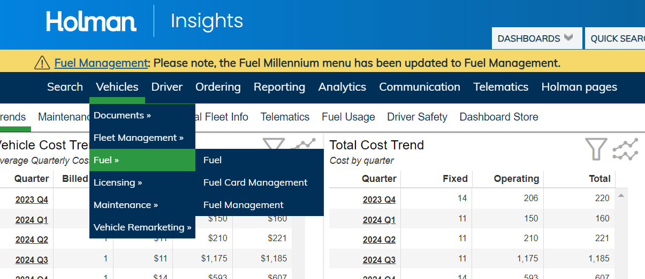
* Login to Holman Insights * Go to Vehicles menu * Go to Fuel menu * Go to Fuel Management
D

Slide 3
* Click on the appropriate Fuel Profile (if you have multiples)
* Scroll down to the bottom of the screen and choose Pin Maintenance

Slide 4
* The PIN Maintenance tab allows the user to create and terminate driver PINs * You can search for a PIN number by entering the Last Name and/or First Name of the driver and then clicking Search
* Helpful Tip: You can sort by Columns and download your assigned PINs to Excel.

Slide 5
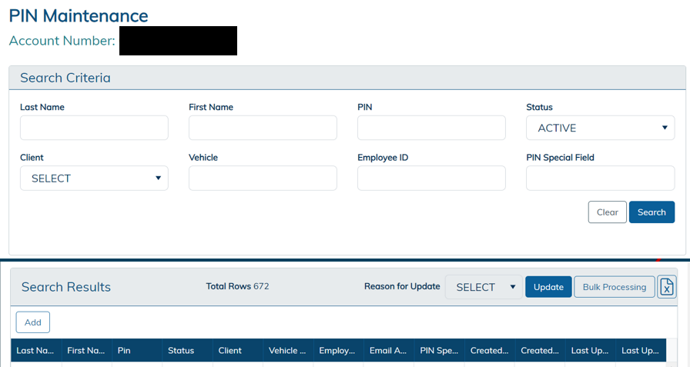
To Create a PIN * Click on “Add” on the bottom left below the Search Results

Slide 6
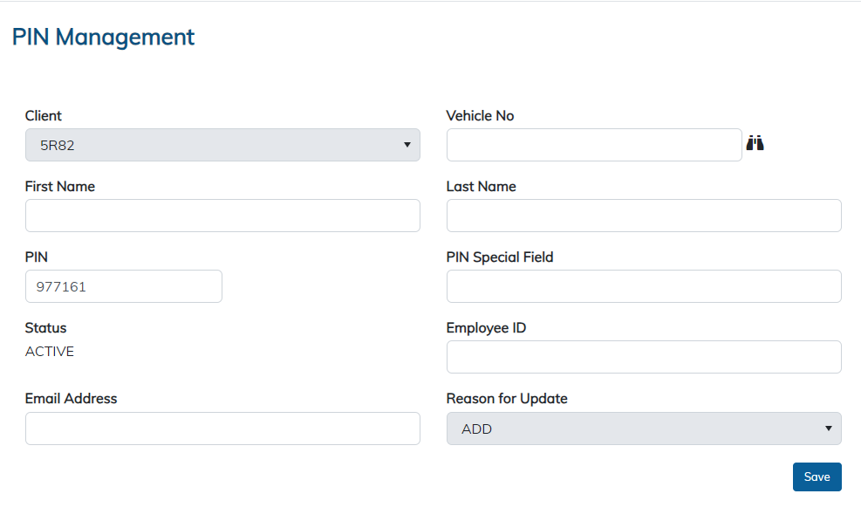
* The PIN Management box appears with a preselected fuel PIN * Select Client as 5R82 * Enter Driver’s First Name, Last Name, and Email Address * Click Save to add PIN to Driver’s Profile

Slide 7
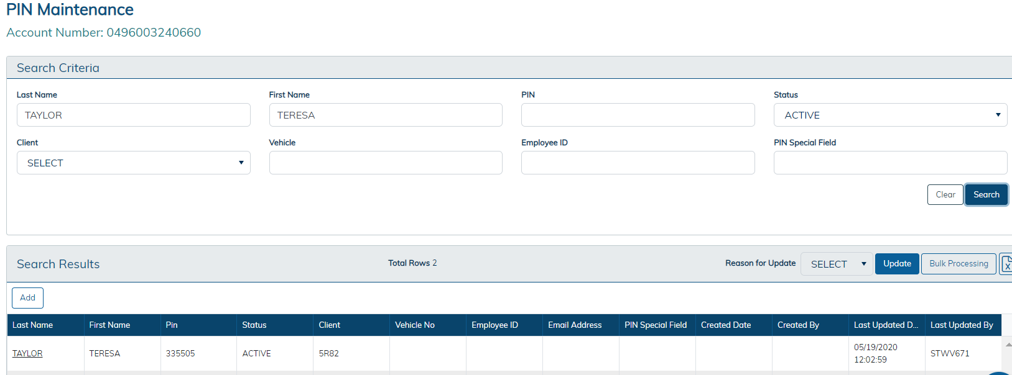
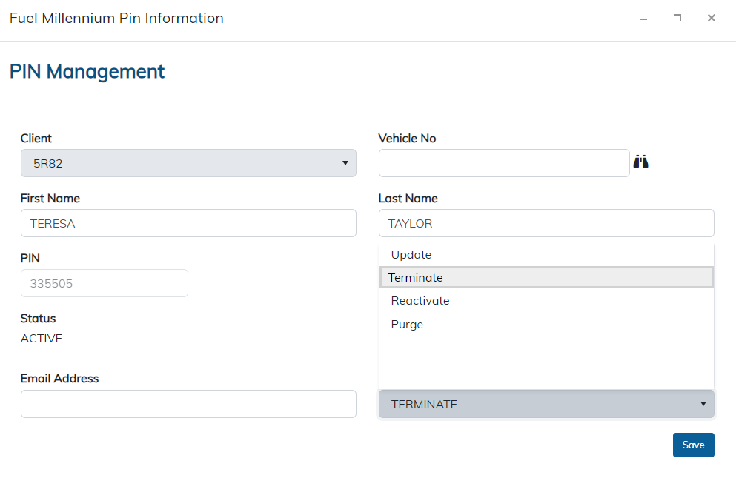
To Terminate a PIN
* Enter the Driver’s Last Name and First Name in the PIN Maintenance Search Criteria
* Click Search
* Click on the Driver’s Last Name to bring up the Pin Management box (Right)
* Choose Terminate from the Reason for Update Dropdown and Click Save
* You can also terminate a PIN by entering the PIN
number in the search criteria and then clicking Save

Slide 8
For additional information or assistance, please contact the Fleet Management Division. Fleet Management Division 2310 Kanawha Blvd E Charleston, WV 25311 Phone: 1-855-817-1910 Email: fleet@wv.gov Website: https://fleet.wv.gov

