Slide 1
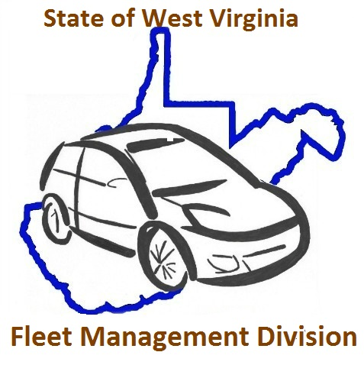
FLEET MANAGEMENT DIVISION DRIVER’S ORIENTATION

Slide 2
FMD’s Mission Statement
Provide safe, efficient, and reliable ground fleet services in the most cost effective manner possible. We will be enablers for state spending units by providing exceptional fleet service, promoting professional development, and working as one team to accomplish the State's strategic goals and objectives.

Slide 3
COMPLIANCE AND SAFE OPERATING PROCEDURES
DEFENSIVE DRIVER TRAINING
TELEMATICS
DRIVER LOGS
VEHICLE INSPECTION CHECKLIST

Slide 4
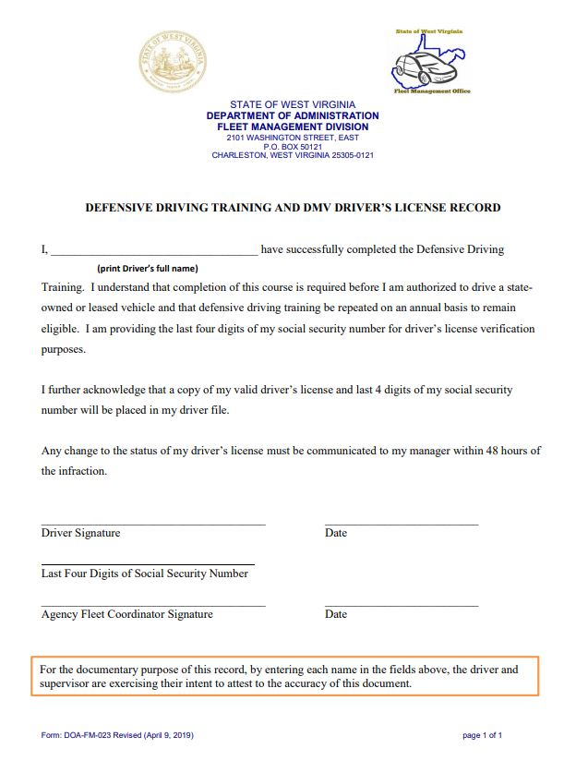
DEFENSIVE DRIVING
Your agency is responsible for ensuring you receive defensive driver training
The Board of Risk and Insurance Management (BRIM) does not currently offer a defensive driving training program, though defensive driver training is a requirement in order to operate a state vehicle
Your AFC is responsible for submitting to BRIM (and retaining internally) the DOA-FM-023 Defensive Driving Training and DMV Driver’s License Record form
FMD’s vendor, Holman (formerly ARI) has a driver safety program accessed through the Driver Insights portal which includes an initial driver skills assessment and personalized training modules based on the assessment results. Additional modules are assigned in March and September to ensure you stay up to date on your driver training
Speak to your Agency Fleet Coordinator if you are interested in signing up. The AFC can contact FMD for full program details and pricing

Slide 5
TELEMATICS
Telematics is a useful tool to monitor the utilization and safe operation of a vehicle.
The role of telematics in fleet management is growing, but the landscape can be complex. In order for fleets to live up to the aspirations of big data and achieve best-in-class performance, telematics must be a central aspect of any comprehensive fleet management program. FMD has contracted with Holman to supply the agencies with Geotab telematics devices.
Your agency may have already implemented this technology in your state vehicle, but if your vehicle does not have telematics and you are interested in having telematics installed, please have your AFC contact the FMD office for program details and pricing.

Slide 6
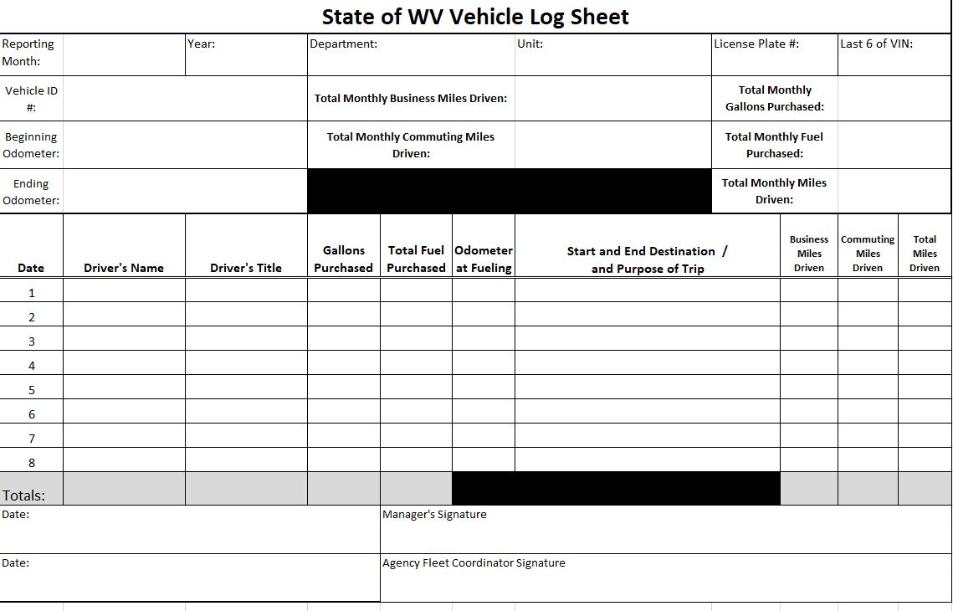
DRIVER LOGS
ALL VEHICLE OPERATORS SHOULD MAINTAIN AN ACCURATE VEHICLE LOG SHEET
COMMUTING MILES RECORDED ON THE VEHICLE LOG SHEET SHOULD BE SUBMITTED TO FLEET MANAGEMENT DIVISION BY YOUR AGENCY FLEET COORDINATOR
VEHICLE LOG SHEETS SHOULD BE RETAINED INTERNALLY BY THE AGENCY
AN EXAMPLE OF A VEHICLE LOG SHEET (DOA-FM-067) CAN BE FOUND ON WWW.FLEET.WV.GOV

Slide 7
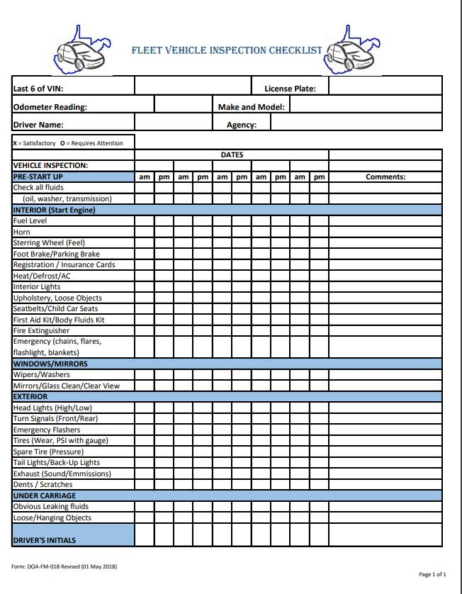
VEHICLE INSPECTION CHECKLIST
VEHICLE OPERATORS SHOULD REFER TO THE REQUIREMENTS STIPULATED IN THE GOVERNOR’S ADMINISTRATIVE POLICY IN SECTION 2.4 (EMPLOYEE RESPONSIBILITY FOR VEHICLE USE) SUBSECTION 2.4.4
VEHICLE OPERATORS SHOULD ALWAYS PERFORM A WALK-AROUND INSPECTION OF THEIR VEHICLE
A SUGGESTION OF A VEHICLE INSPECTION CHECKLIST (DOA-FM-018) CAN BE FOUND ON WWW.FLEET.WV.GOV

Slide 8
Vehicle contents
ADMINISTRATIVE POLICY: EMPLOYEE USE OF EMPLOYER PROVIDED MOTOR VEHICLES
HOLMAN FUEL CARD
HOLMAN MAINTENANCE PACKET
LEASE AGREEMENT TERMS AND CONDITIONS
ACCIDENT POLICIES AND PROCEDURES
BRIM INSURANCE LOSS NOTICE FORM
INSURANCE CARD (RENEWAL DUE EVERY JULY 1ST)
HOLMAN CONTACT: CALL 1-800-CAR-CARE

Slide 9
STATE OF WEST VIRGINIA ADMINISTRATIVE POLICY: EMPLOYEE USE OF EMPLOYER PROVIDED MOTOR VEHICLES
This policy is to be reviewed by each driver of a state-owned vehicle annually.
Speak to your AFC on the appropriate method of training for your agency. Some agencies will utilize the state’s learning management system (CourseMill) and some may have an alternate portal for viewing a presentation of the policy.
Compliance must be documented with DOA-FM-011 by January 15 of each calendar year and should be retained internally by your agency.
A copy of this administrative policy must be kept in each employer provided vehicle.

Slide 10
HOLMAN FUEL CARD & DRIVER PIN INFORMATION
A HOLMAN CARD IS ASSIGNED TO A VEHICLE
A PIN IS ASSIGNED TO A DRIVER
THE HOLMAN CARD IS TO BE USED ONLY FOR FUEL PURCHASES
YOUR PIN IS ASSIGNED BY YOUR AGENCY FLEET COORDINATOR. IF YOUR PIN IS COMPROMISED, NOTIFY YOUR AFC IMMEDIATELY SO THEY CAN TERMINATE/ISSUE YOU A NEW PIN
YOUR HOLMAN CARD IS ISSUED THROUGH FLEET MANAGEMENT DIVISION. IF YOUR FUEL CARD IS COMPROMISED, NOTIFY YOUR AFC IMMEDIATELY. THEY WILL CONTACT FMD AND WE WILL TERMINATE/ISSUE A NEW FUEL CARD FOR YOUR VEHICLE

Slide 11
Fuel card user agreement
ALL FUEL CARD USERS SHOULD COMPLETE THE DOA-FM-031 FUEL CARD USER AGREEMENT FORM AND SUBMIT TO THEIR AGENCY FLEET COORDINATOR.

Slide 12
Fuel Purchase Procedures
THE HOLMAN-BRANDED WEX FUEL CARD IS:
ACCEPTED NATIONWIDE AT FUEL STATIONS IN THE UNITED STATES
USED IN THE SAME MANNER AS ANY CREDIT CARD
DRIVER INSERTS CARD INTO PUMP
REQUIRES THE OPERATOR TO ENTER, AS PROMPTED, THEIR ASSIGNED PIN NUMBER, AND THE CURRENT MILEAGE FROM THE VEHICLE’S ODOMETER
DRIVER SAVES RECEIPTS TO GIVE TO COORDINATOR TO RECONCILE ACCOUNT AT THE END OF MONTH

Slide 13
HOLMAN MAINTENANCE
1-800-CAR-CARE (1-800-227-2273)
Certified Mechanic
Available 24 hours a day, 7 days a week for 365 days a year
Maintenance
Repairs
Warranty Services
Emergency and Roadside Assistance

Slide 14
HOLMAN MAINTENANCE information & PROPER MAINTENANCE OF A STATE VEHICLE
A MAINTENANCE REFERENCE DOCUMENT WILL BE PROVIDED FOR ANY VEHICLE ASSIGNED WITH HOLMAN MAINTENANCE SERVICES
PRIOR TO TAKING TO A SHOP, THE VEHICLE OPERATOR CALLS 1-800-CAR-CARE AND DISCUSSES THE NEED WITH A HOLMAN CERTIFIED MECHANIC
HOLMAN REVIEWS THE VEHICLE’S MAINTENANCE AND REPAIR HISTORY AND RECOMMENDS A HOLMAN-APPROVED VENDOR THAT BEST FITS THE REPAIR NEEDED AND THE CURRENT VEHICLE LOCATION
THE OPERATOR TAKES THE VEHICLE TO THE RECOMMENDED FACILITY
THE FACILITY CONTACTS HOLMAN TO REVIEW THE WORK REQUESTED AND FOR AUTHORIZATION OF THE REPAIR AND THE COST OF PERFORMING THE WORK. REMEMBER THAT ALL REPAIRS OVER YOUR AGENCY-DESIGNATED MONETARY THRESHOLD WILL REQUIRE THE REVIEW AND APPROVAL FROM YOUR AGENCY FLEET COORDINATOR. PLEASE KEEP THIS IN MIND WHEN YOU TAKE THE VEHICLE TO A FACILITY AND PLAN TO WAIT FOR REPAIRS TO BE COMPLETED
REMEMBER TO CONTACT HOLMAN PRIOR TO SCHEDULING ANY REPAIRS FOR A VEHICLE AS THIS HELPS HOLMAN TRACK/MANAGE EXTRANEOUS ADD-ON CHARGES THAT MAY NOT RELATE TO YOUR ORIGINAL REASON FOR SCHEDULING MAINTENANCE

Slide 15
HOLMAN MAINTENANCE PACKET & PROPER MAINTENANCE OF A STATE VEHICLE CONT.
ALL CAR WASHES SHOULD BE PERFORMED THROUGH A HOLMAN-APPROVED VENDOR
A TOTAL OF 2 DETAILS ARE PERMITTED PER YEAR BY HOLMAN
THE VEHICLE SHOULD BE CLEANED WEEKLY

Slide 16
Emergency and Roadside Assistance
In the event roadside assistance is needed, the vehicle operator is to contact Holman for an assessment of needed services, such as towing, emergency repairs, or locksmith services.

Slide 17
Recall Notices
The Agency Fleet Coordinator is notified of their agency’s vehicle safety recalls through their Holman dashboard widget
If a vehicle is assigned to a driver and that driver’s email address is listed in the vehicle’s profile IN Holman, the driver will also receive an emailed notification of the vehicle’s safety recall
Vehicle operator should take vehicle to facility
Facility performs the specified work
Facility notifies the manufacturer that the work was completed
Manufacturer sends an update to Holman

Slide 18
ACCIDENT PROCEDURES
IN THE EVENT OF ANY COLLISION, THE VEHICLE OPERATOR IS TO FOLLOW THESE STEPS:
CONTACT THE LOCAL LAW ENFORCEMENT AGENCY WHERE THE COLLISION OCCURRED
CONTACT HOLMAN (1-800-CAR-CARE) FOR TOWING, IF NEEDED
CONTACT THE AGENCY FLEET COORDINATOR ASAP AND REFER TO THE ACCIDENT PROCEDURES PROVIDED IN YOUR VEHICLE PACKET
REMINDER: ACCIDENT REPAIRS ARE NOT USUALLY PAID THROUGH HOLMAN

Slide 19
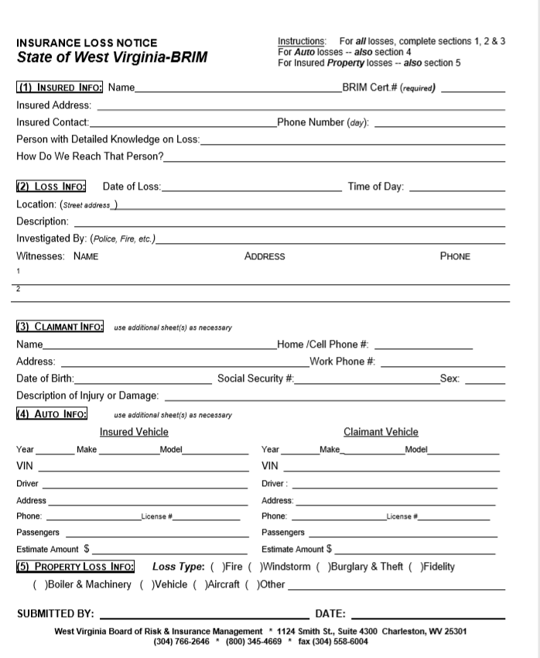
INCIDENT REPORTING
If the damage is more than the deductible but less than $2500, the insurer may be able to address the claim based solely on one or more estimates.
The insurer reserves the right to inspect all damages prior to repairs being completed.
Prior to securing estimates, the spending unit should await contact from the insurer as to how it wishes to proceed.

Slide 20
REPORTING OF AGENCY VEHICLES TO BRIM
EACH YEAR BRIM REQUIRES A REPORT OF YOUR AGENCY VEHICLES
STEPS:
VISIT WWW.STATE.WV.US/BRIM
GO TO THE UNDERWRITING SECTION:
EACH AGENCY SHOULD HAVE THEIR OWN ACCOUNT TO LOG INTO WITH THEIR FEIN #
PASSWORD : XXXXXX
GO TO SECTION THREE TO UPDATE NEW VEHICLE INFORMATION

Slide 21
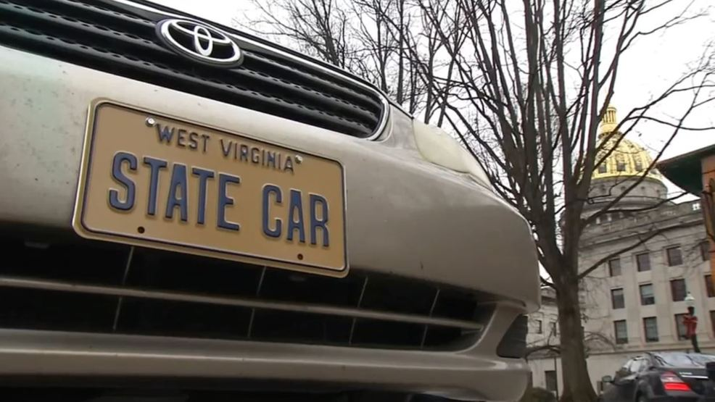
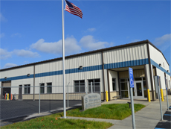
WV State Agency for Surplus Property (WVSASP) Used Vehicle Delivery Requirements
Fleet Coordinators must contact WVSASP five business days in advance of vehicle deliveries. Signed titles must be brought with the vehicle and WVSASP must have an approved FD retirement.
Vehicles must be delivered to WVSASP if they are located within 100 miles of our Dunbar location and have an estimated value of $1,000 or more.
Vehicles must be clean inside and out and all personal items removed. Vehicles do not have to be detailed. All trash must be removed.
Vehicles must have a minimum of 1/8 tank of gas.
No cracks in the windshield. WVSASP will not accept a vehicle if the crack is fanned out or the windshield is smashed. Small rock chips will be accepted.
No accident body damage. The damage should be repaired using the state insurance. Minor scratches and dings do not need to be repaired.
All Agency/State identifying decals must be removed.
All cages must be removed from vans unless prior approval is received from WVSASP.
Vehicles must have catalytic converters.
WVSASP will inspect all vehicles upon arrival at the Surplus lot in Dunbar. WVSASP reserves the right to refuse delivery of vehicles based on that inspection. Please note that if the conditions above are not met, WVSASP will not accept delivery of the vehicles. Persons dropping vehicles off are to be present for inspections and are not to leave the Surplus lot until the vehicles have been accepted by WVSASP. Please allow adequate time for inspections when dropping off vehicles. WVSASP will not take possession of vehicle keys until after the vehicles have been inspected and accepted.

Slide 22
VEHICLE VIOLATIONS AND COMPLAINTS
EVERY STATE TAG IS A TARGET
EACH STATE TAXPAYER FEELS THEY OWN A PART OF EACH VEHICLE
ALL VIOLATIONS AND COMPLAINTS RECEIVED BY FMD ARE FORWARDED TO THE AGENCY FLEET COORDINATOR AND SHOULD BE EVALUATED AND ADDRESSED WITH THE RESPONSIBLE INDIVIDUAL
The public’s expectation is that an operator will always operate
the vehicle within the limits of the law, in a courteous
manner, and to travel safely.

Slide 23
PLEASE REMEMBER
FAMILIARIZE YOURSELF WITH YOUR ASSIGNED VEHICLE
WALK AROUND THE VEHICLE AND MAKE SURE TO ADVISE OF ANY DAMAGE NOTED
OPERATORS ARE TO CARE FOR THE VEHICLE AS THEY WOULD THEIR OWN
TAKE CARE OF THE VEHICLE AND KEEP IT CLEAN AT ALL TIMES
STATE OWNED VEHICLES ARE FOR BUSINESS ONLY
STATE OWNED VEHICLES ARE CLEARLY IDENTIFIED

Slide 24
Please make every effort
to be good stewards
of the state of
West Virginia

Slide 25
LEASE AGREEMENT TERMS AND CONDITIONS
Vehicles are leased at the discretion of the Lessor. Acceptance of vehicle from the location designated by FMD as the retrieval location will constitute acceptance of lease terms and conditions regardless of whether agreement is signed.
Rates for each vehicle will be evaluated each fiscal year and adjusted up or down as needed.
Lessee is responsible for operating expenses, damages, abuse, accidents, neglect, maintenance, and cleaning as well as payment of parking and driving violations.
All travel must be for official State business. No personal business or travel is authorized or permitted. The state of WV Governor's Policy for Employee Use of Employer Provided Motor Vehicles must be read by each operator of a State vehicle
Seat belts must be worn at all times.
All state of West Virginia and other applicable motor vehicle laws, including speed limits, must be obeyed.

Slide 26
TERMS AND CONDITIONS CONT.
No smoking or vaping is allowed in the vehicle.
Alcohol or illegal drugs are prohibited at all times.
Use of wireless communication devices is prohibited while the vehicle is in motion except when the wireless communication device is being used hands-free or if the operator fears for his, her, or another person's life or safety.
Any modifications to the vehicle must have the approval of the Fleet Management Director. Tampering with installed equipment, including telematics devices, is strictly prohibited.
Lessee will verify that all operators of state owned vehicles have a valid driver's license.
Lessee agrees to return vehicle for underutilization, misuse, serious DMV violations, at-fault accidents or any other inappropriate activities at the discretion of the Lessor.

Slide 27
TERMS AND CONDITIONS CONT.
Vehicle condition at the end of the lease must be relative to the age/mileage of the vehicle. Any necessary repairs/reconditioning above normal guidelines for age and levels of service are the responsibility of the Lessee.
Vehicle must be locked at all times when not in use.
Lessee agrees to driver training as required by the spending unit.
Vehicle must be cleaned, interior and exterior, at Lessee's expense at least monthly.
Service performed under this agreement may be continued in succeeding fiscal years for the term of the agreement, contingent upon funds being appropriated by the Legislature or otherwise being available for this service. In the event funds are not appropriated or otherwise available for this service, the agreement shall terminate without penalty on June 30. After that date, the agreement becomes of no effect and is null and void. However, the agency agrees to use its best efforts to have the amounts contemplated under the agreement in its budget. Non-appropriation or non-funding shall not be considered an event of default.

Slide 28
THANK YOU FOR reviewing THIS TRAINING!
FOR QUESTIONS, CONTACT FLEET MANAGEMENT DIVISION:
EMAIL: FLEET@WV.GOV
CALL TOLL FREE: 1-855-817-1910
WEBSITE: WWW.FLEET.WV.GOV

