Slide 1
Fleet Management
Agency Fleet Coordinator Training
Part 1 – Introduction, Code, Rule,
Policies, and Responsibilities
Part 2 – Holman/Current Fleet
Management
Part 3 – Additional Services
Part 4 - wvOASIS
https://fleet.wv.gov

Slide 2
Fleet Management
Agency Fleet Coordinator Training
Part 1 – Introduction, Code, Rule,
Policies, and Responsibilities
Introduction
WV Code §5A12
Rule148-3
Rule 148-23
Governor’s Policy
AFC’s Responsibilities

Slide 3
Fleet Management Division Assigned Accounts
Accounts are assigned by cabinet to give agencies a central point of contact for FMD. This is done to make each interaction an efficient and positive experience
Each account representative has over roughly 2,500 vehicles
The account representatives will be whom AFCs contact for fueling, maintenance, Holman, and any other vehicle related questions
Account representatives also oversee setting up Holman access and maintenance approval levels for their prospective agencies
To request Holman access and set up maintenance approval levels, an AFC needs to fill out a DOA-FM-033 Holman User Access Request form and submit it to their account representative

Slide 4
Fleet Management Division Assigned Accounts
FMD Provides
Fueling Services
Maintenance Services
Vehicle Acquisitions and Financing through Statewide Contracts
Telematics
Driver Safety Program
Carpool Reservation System and Kiosk
Mandated Reporting Requirements

Slide 5
Fleet Management Division Assigned Accounts
James Parsons
Cabinet Levels Include: Administration, Commerce, DHHR, Environmental, Higher Education, Revenue, Senior Services, Arts, Culture and History
Email: James.A.Parsons@wv.gov
Phone: (304) 558-0086
Teresa Taylor
Cabinet Levels Include: Elected Officials, Homeland Security, Veteran’s, Miscellaneous, Quasi, Judicial, Legislative, Education, Community College
Email: Teresa.D.Taylor@wv.gov
Phone: (304) 957-8253
Stephanie Lane
Cabinet Levels Include: Transportation
Email: Stephanie.E.Lane@wv.gov
Phone: (304) 558-2614
https://fleet.wv.gov
Toll Free: 1-855-817-1910

Slide 6
Legislative Policies Concerning State Owned and Operated Vehicles
WV Code §5A-12
Administrative Rule Title 148 Series 3 State-Owned Vehicles
Governor’s Office Administrative Policy, Employee Use of Employer Provided Motor Vehicles
Complete Versions Can Be Found On Fleet Management Division’s Website
https://www.fleet.wv.gov

Slide 7
WV Code § 5A-12
Annual report
Auditor’s Office 20% compliance
Mandates agencies use FMD’s services for maintenance and fueling requiring spending units to send FMD a list of bona fide noncompensatory business reasons for which a state vehicle is being provided to each employee on or before July 1st of each year
bona fide noncompensatory business reasons means that a vehicle is assigned to the employee, and that employee commutes to and from home and the work location in that vehicle for business purposes
Reporting form DOA-FM-HB-103 found on FMD webpage
https://fleet.wv.gov/AFC_Resources/Pages/default.aspx

Slide 8
Legislative Rule 148CSR03
Administration Rule Title 148 Series 3 State-Owned Vehicles
Passed during the 2018 Legislative Session, effective date 4/3/2019
Expands on WV Code §5A-12
Provides dates and identifies the data and information that needs to be maintained and reported
AFC Reporting Checklist can be accessed at this link:

Slide 9
Agency Fleet Coordinators 148-03
Rule §148-3-3 is an expansion of HB4015 §5A-12-8
sections a, b, c, and d

Slide 10
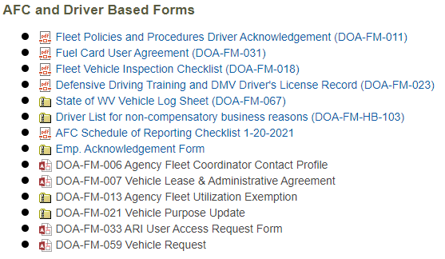
Spending Units Shall Name a Fleet Coordinator and Submit to FMD
https://fleet.wv.gov

Slide 11
AFC Responsibilities
AFCs are responsible for:
Making sure that all driver and overnight parking address information for each vehicle is entered into Holman
AFCs are responsible for making sure that a maintenance approval hierarchy is in place for all vehicles
Making sure invoices from Holman maintenance, fuel, lease payments, and others are routed to appropriate accounts payable representative in your agency
Collecting and filing vehicle logs
Providing monthly odometer reading for those vehicles that do not use FMDs fueling
services or have not utilized the service in the past 60 days
All commuting miles MUST be reported monthly to FMD
Assigning fueling PIN numbers
Drivers Acknowledgement Form
Completing, approving, and routing of vehicle requests for new, decommission, and/or reassigning a state vehicle
Training drivers on all policies, procedures, rules, and code related to operating a state vehicle

Slide 12
AFC Responsibilities
AFCs are responsible for:
Communication with fixed asset person regarding entry of agency-owned vehicle into OASIS-remember this must be done prior to receiving state plates
Updating vehicle information with BRIM and Holman
Forwarding all communication from FMD to the appropriate person within your spending unit
Ordering vehicles for replacement
Driver training
Valid Drivers License
Accident procedures
Reporting requirements

Slide 13
State-Owned vehicle data required to be reported to FMD
Rule 148-3-11
11.1. Each spending unit with state-owned vehicles shall conduct an annual survey of its fleet and reconcile its vehicle records with those of the Fleet Management Division and with the centralized inventory database maintained by the Enterprise Resource Planning Board.
11.2. Agency fleet coordinators shall provide by October 31st each year, or upon request, to the Fleet Management Division data on each state-owned vehicle, including:
11.2.a. vehicle identification number;
11.2.b. manufacturer, make, model and year of the vehicle;
11.2.c. class or type of each vehicle;
11.2.d. license plate number of each vehicle;
11.2.e. date of acquisition of each vehicle;
11.2.f. vehicle inspection records of each vehicle;
11.2.g. annual costs associated with vehicle rental expenses;

Slide 14
State-Owned vehicle data required to be reported to FMD
Rule 148-3-11
11.2.h. annual reimbursement by the agency for employees’ personal vehicle use which
shall include total miles and reimbursement rate;
11.2.i. funding source for each vehicle (department number, unit number and
fund number);
11.2.j. odometer readings for each vehicle;
11.2.k. fuel usage of each vehicle;
11.2.l. all maintenance events associated with each vehicle; and
11.2.m. annual total indirect costs of operating state-owned vehicles for the agency.
11.3. The Fleet Management Division will provide to the Governor and Joint Committee
on Government and Finance an annual report of state vehicle usage, including
operating costs and the number of vehicles.
By using FMD’s fueling and maintenance services, reports can be run out of
Holman to meet mandatory reporting requirements

Slide 15
Agency Fleet Coordinator Schedule of Reporting Checklist

Slide 16
Governor’s Office Administrative Policy
Employee Use of Employer Provided Motor Vehicles
This policy is to be reviewed by each driver of a state-owned vehicle by January 15 of each year
A copy of this policy must be kept in each employer provided vehicle.
The Governor’s Policy and DOA-FM-011 Form can be found here:
https://fleet.wv.gov/new-driver-orientation/Pages/default.aspx
Signed DOA-FM-011 forms should be retained internally by the agency

Slide 17
Bona Fide Noncompensatory Employees Who
Are Provided a State Vehicle Source Rule 148-03
DOA-FM-HB-103 FORM TO BE PROVIDED TO FMD ON OR BEFORE JULY 1ST
OF EACH YEAR
2.3. “Commuting” means the use of a state vehicle by an employee who has been assigned a state vehicle, whether permanent or temporary, to drive to and from the employee’s home and regular place of employment, in accordance with the Internal Revenue Service Publication 15-B, Employer’s Tax Guide to Fringe Benefits.
2.4. “De Minimis personal use” means the use of a state-owned vehicle for personal purposes, of which the value of that personal use is so small that accounting for it would be unreasonable and administratively impractical, including while commuting when permitted, in accordance with the Internal Revenue Service Publication 15-B, Employer’s Tax Guide to Fringe Benefits.

Slide 18
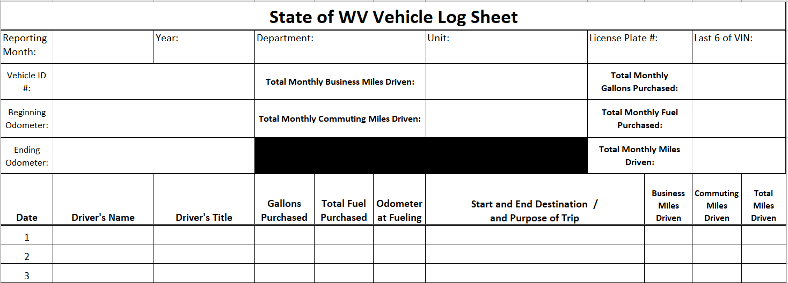
VEHICLE LOG
Legislative Rule §148-3-7
Utilizing telematics eliminates the need for a paper vehicle log
Rule §148-3-7 is an expansion of §5A-12-10b

Slide 19
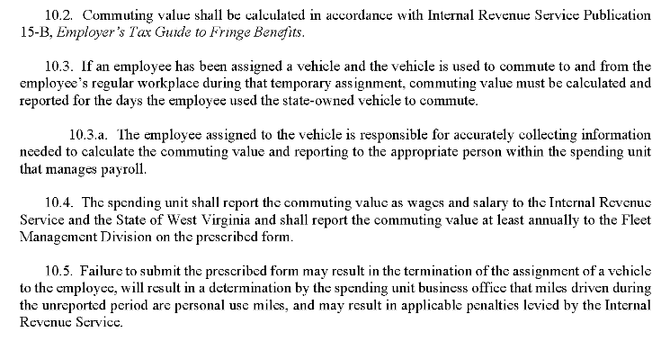
§148-3-10. Commuting in state-owned vehicles
The Governor's Office Administration Policy concerning the Employee use of Employer Provided Motor Vehicle provides examples and clarification concerning
the proper use of a state vehicle

Slide 20
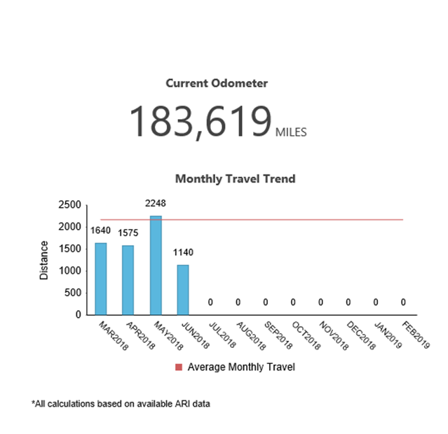
MINIMUM UTILIZATION
JULY 1 BEGINNING OF FISCAL YEAR UTILIZATION FORMS ARE VOID AND NEW FORMS MUST BE SUBMITTED
REVIEW THIS SECTION OF THE LEGISLATIVE RULE FOR CATEGORIES OF EXEMPTIONS TO BE USED WITH FORM
DOA-FM-013
Rule §148-3-9 is an expansion on WV Code §5A-12-8a
Notes:
PLEASE READ THE COMPETE SECTION

Slide 21
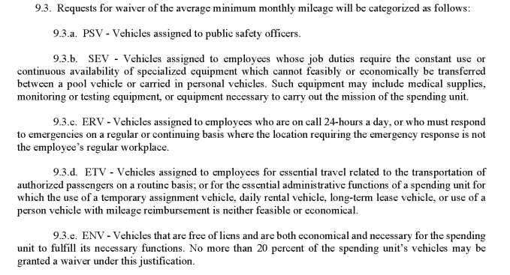
Utilization Exemption Requests
This report is due July 31 of each year. Each spending unit must report the number of occasions off-hours/after-hours that
a vehicle was utilized for categories SEV or ERV
Notes:
Holman report – talk to TIM

Slide 22
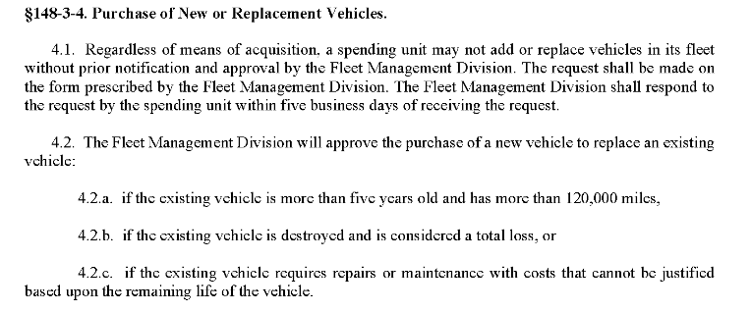
Fleet Replacement and Lifecycle Management
Under Agency Fleet Coordinator Resources on FMD’s website are instructions,
updated yearly, on how to order and decommission state vehicles
https://fleet.wv.gov/AFC Resources

Slide 23
Mandatory Forms that Must be Submitted to Fleet Management Division
DOA-FM-006 Agency Fleet Coordinator Contact Profile
This form is to be used to designate the Agency Fleet Coordinator for your agency. It is also used when you want to modify the existing Agency Fleet Coordinator
DOA-FM-007 Vehicle Lease and Administrative Agreement
This form is pre-filled by the FMD Fleet Coordinator for any vehicle that has been leased through Fleet
Management Division or has requested Holman services. The form is then sent to the AFC who is
responsible for ensuring completion of the driver information and signature sections
DOA-FM-013 Agency Fleet Utilization Exemption
This form is to be submitted annually (on or before July 1st of each year) and should denote the specified reason for the vehicle’s underutilization
DOA-FM-021 Vehicle Purpose Update
This form should be submitted annually on or before October 1st/as needed to provide the usage types of the vehicles in your fleet

Slide 24
Mandatory Forms for Fleet Management Division
DOA-FM-059 Vehicle Request
This form is to be submitted to FMD anytime a vehicle is being acquired or decommissioned, prior to occurrence. All vehicle acquisitions must first receive approval from the Cabinet Secretary of the agency prior to submission to the Fleet Management Division Director. FMD will forward approved requests to the Governor’s Office for final approval of the document (unless the agency in question is exempt from the Governor’s Office approval)
DOA-FM-HB-103 Driver List for noncompensatory business reasons
This form should be completed to specify the bona fide noncompensatory business reasons for which a state vehicle is provided to an employee. Should be submitted to FMD on or before July 1st of each year
DOA-FM-067 State of WV Vehicle Log Sheet
Submission is mandatory ONLY if commuting mileage is recorded
All commuting miles should be reported to FMD on a monthly basis. This form provides a template for the information your vehicle log sheet should include. If no commuting miles are driven, this form should not be submitted to FMD and should be retained internally only

Slide 25
Mandatory Forms that Must be Retained at the Agency Level
DOA-FM-011 Fleet Policies and Procedures Driver Acknowledgement
This acknowledgement form refers to the review of the Governor’s administrative policy on Employee use of Employer Provided Motor Vehicles. It should be completed by your drivers annually by January 15th of each year. It also should be completed by any new drivers your agency assigns. The form should be retained internally and should not be submitted to FMD
DOA-FM-023 Defensive Driving Training and DMV Driver's License Record
This form should be completed both annually, and as needed, and submitted to BRIM as well as retained internally
DOA-FM-031 Fuel Card User Agreement
This acknowledgement form should be used prior to your drivers utilizing a Holman fuel card. This should be retained internally and should not be submitted to FMD

Slide 26
Mandatory / Adjustable forms for your use
DOA-FM-018 Fleet Vehicle Inspection Checklist
This form provides a helpful template for your driver’s vehicle inspection. This form can be modified to better suit your agency’s mission for the vehicle. Should be retained internally and should not be submitted to FMD.
DOA-FM-067 State of WV Vehicle Log Sheet
This form provides a template for the information your vehicle log sheet should include. This form can be modified to better suit your agency’s mission for the vehicle. Should be retained internally with the exception if commuting miles are driven. All commuting miles should be reported to FMD on a monthly basis

Slide 27
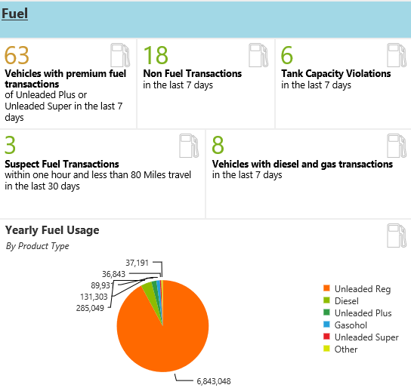
Fuel and Maintenance Per 148CSR03
Rule §148-3-12 is an expansion on WV Code §5A-12-9a, which states “Each spending unit that owns, uses, or maintains a state vehicle shall utilize the vehicle management services provided by the Fleet Management Division for all state vehicles”

Slide 28
Basic Fueling Rules
Fueling cards are assigned to the vehicle
The fueling how to is on FMDs website https://fleet.wv.gov/fueling
PIN numbers are assigned to a driver; drivers should never share them
Drivers must complete DOA-FM-031 Fuel Card User Agreement
This form is retained at the agency
Lost cards need to be reported to FMD asap
A replacement card will be ordered
FMD maintains a few loaner cards to bridge any gaps
Loaner cards must be returned when permanent cards are received
If not returned, the loaner card will be terminated by FMD

Slide 29
Maintenance Approval Process
Agencies must approve all maintenance events on their vehicles
They must establish a hierarchy of contacts for maintenance approvals
There are 6 levels of maintenance approval contacts with the FMD account
manager always being the 6th or last level
The 1st contact listed will be contacted first should Holman need to contact someone about a vehicle going in for maintenance. If Holman cannot reach the 1st contact, they will move down the approval contacts list
In most cases the maintenance approver is contacted through email
A dollar threshold can be set for maintenance approvals
FMD recommends $100 threshold
The Driver of the vehicle cannot be the maintenance approver for that vehicle

Slide 30
Maintenance Approval Process
Below is an example of an FMD vehicle with the maintenance approval hierarchy set up
with a $500 threshold

Slide 31
Fleet.wv.gov
Don’t forget that the Fleet Management Division has many helpful resources available on their website
Many forms to help with everything involved with ordering and operating a state vehicle https://fleet.wv.gov/AFC_Resources/Pages/default.aspx
Forms and other resources for drivers of state vehicles https://fleet.wv.gov/new-driver-orientation/Pages/default.aspx
Instructions on various aspects of a fuel card for a state vehicle https://fleet.wv.gov/fueling/Pages/default.aspx
Instructions on various aspects of maintenance for a state vehicle https://fleet.wv.gov/Maintenance/Pages/default.aspx
Updated news and current events at FMD
Many informative data reports including FMD’s annual report https://fleet.wv.gov/reports/Pages/default.aspx
And a frequently asked questions page that answers FMD’s most asked questions https://fleet.wv.gov/FAQ/Pages/default.aspx

Slide 32
Fleet Management
Agency Fleet Coordinator Training
Part 2 – Holman Insights
Dashboard and Widgets
Quick Search
Search Tab
Reporting Tab
Maintenance Approval Process and Manual PO Entry
Asset and Contacts Management Tab
Combined Inventory Management View with Driver Updates View
Telematics
Driver Safety Program

Slide 33
Holman Insights
https://insights.holman.com

Slide 34
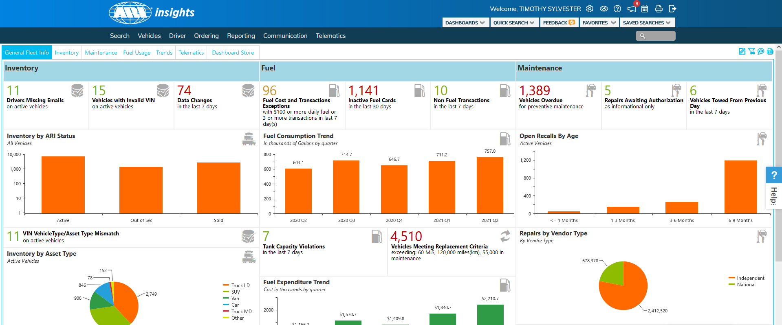
Holman Insights Dashboard/Widgets
Dashboard/General Fleet Info
Three biggest tabs are Inventory, Fuel Usage, and Maintenance
Telematics is a useful dashboard for any agency using that program

Slide 35
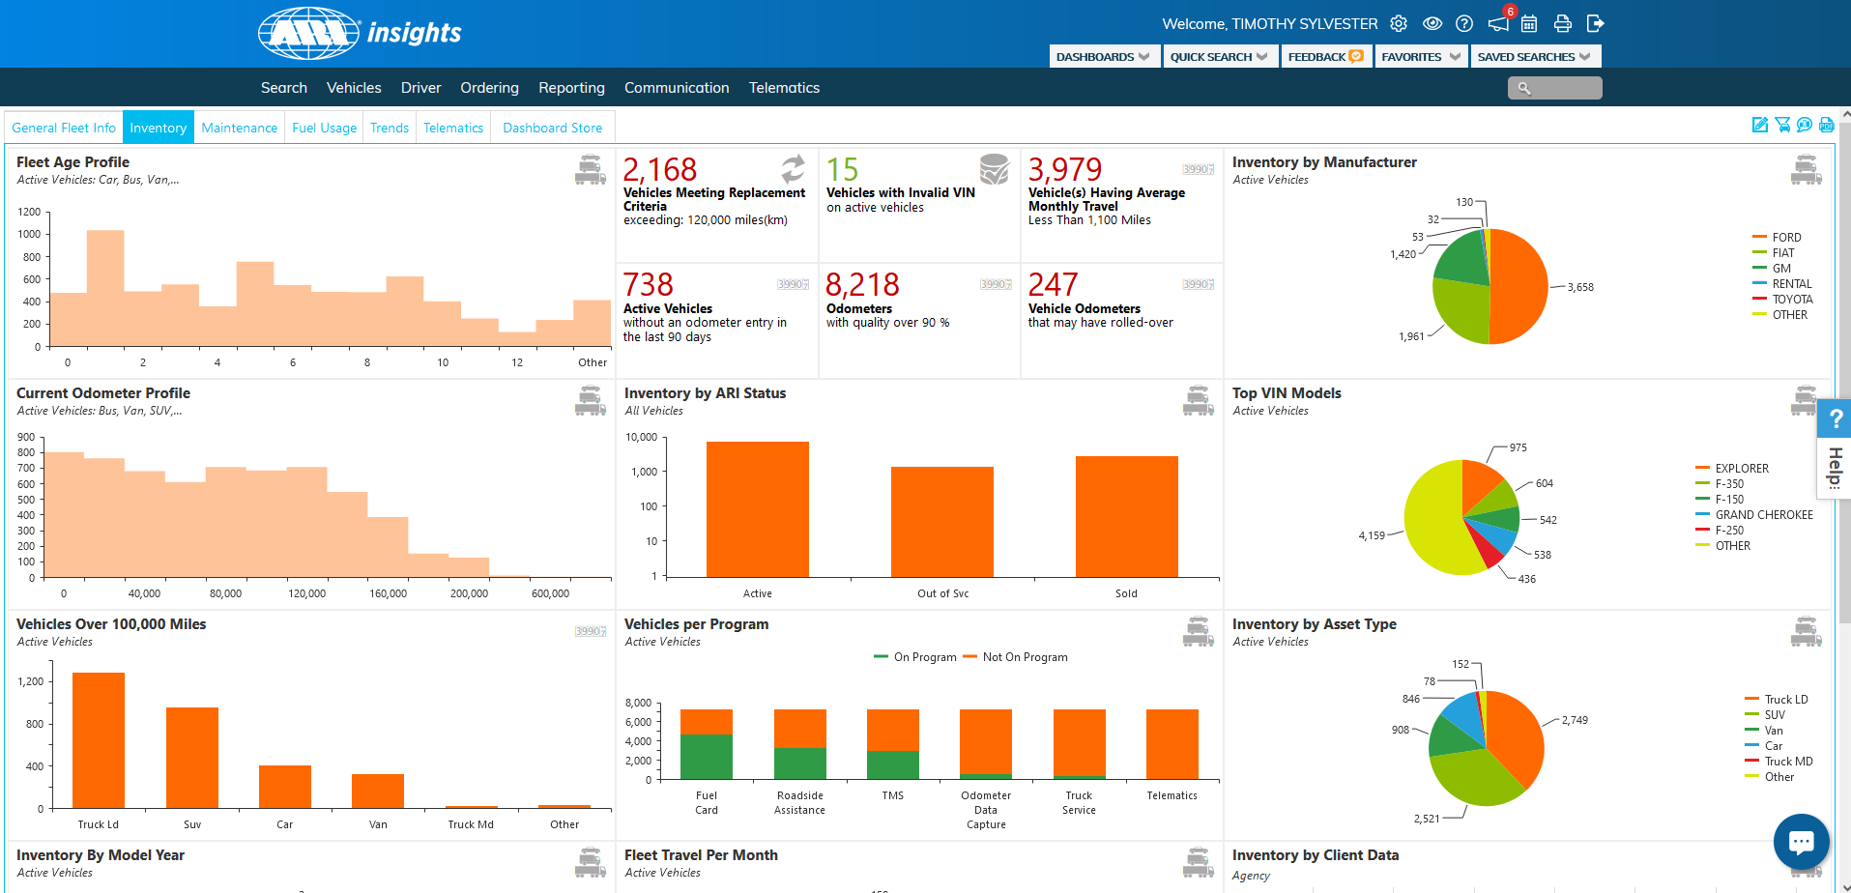
Holman Insights Dashboard/Widgets
Inventory Dashboard

Slide 36
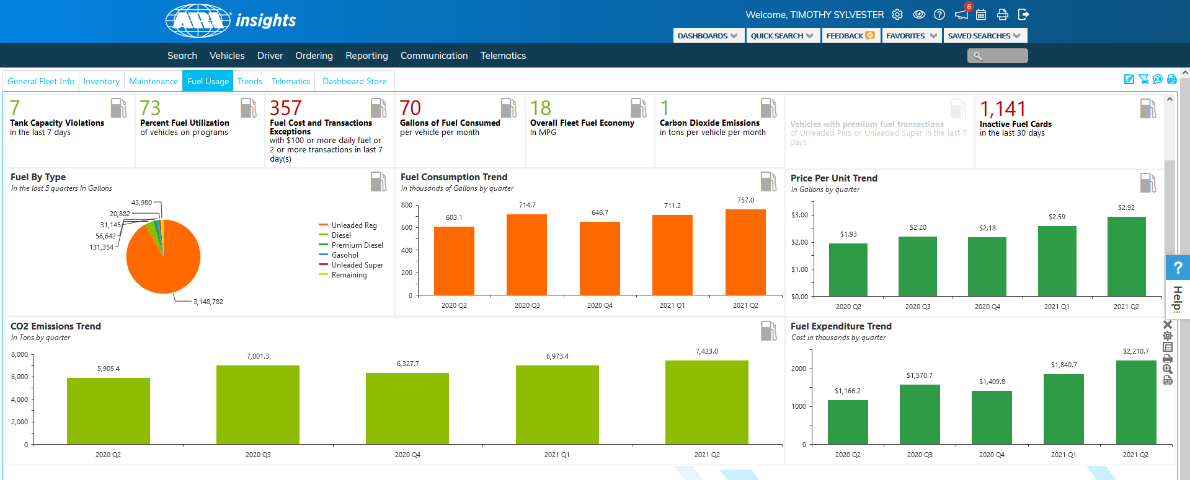
Holman Insights Dashboard/Widgets
Fuel Usage

Slide 37
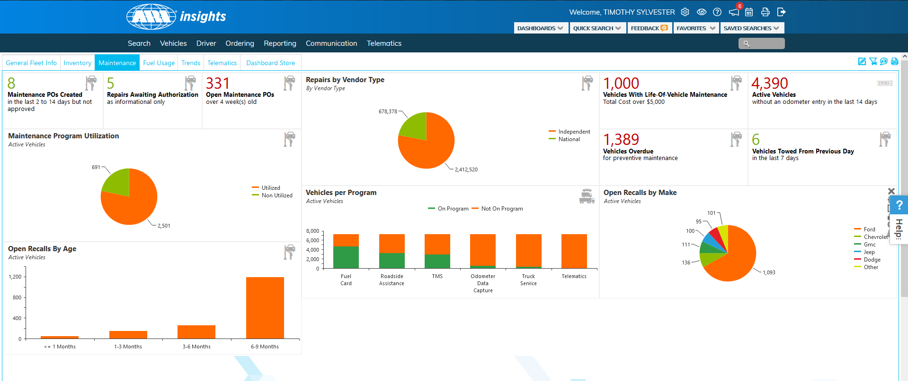
Holman Insights Dashboard/Widgets
Maintenance

Slide 38
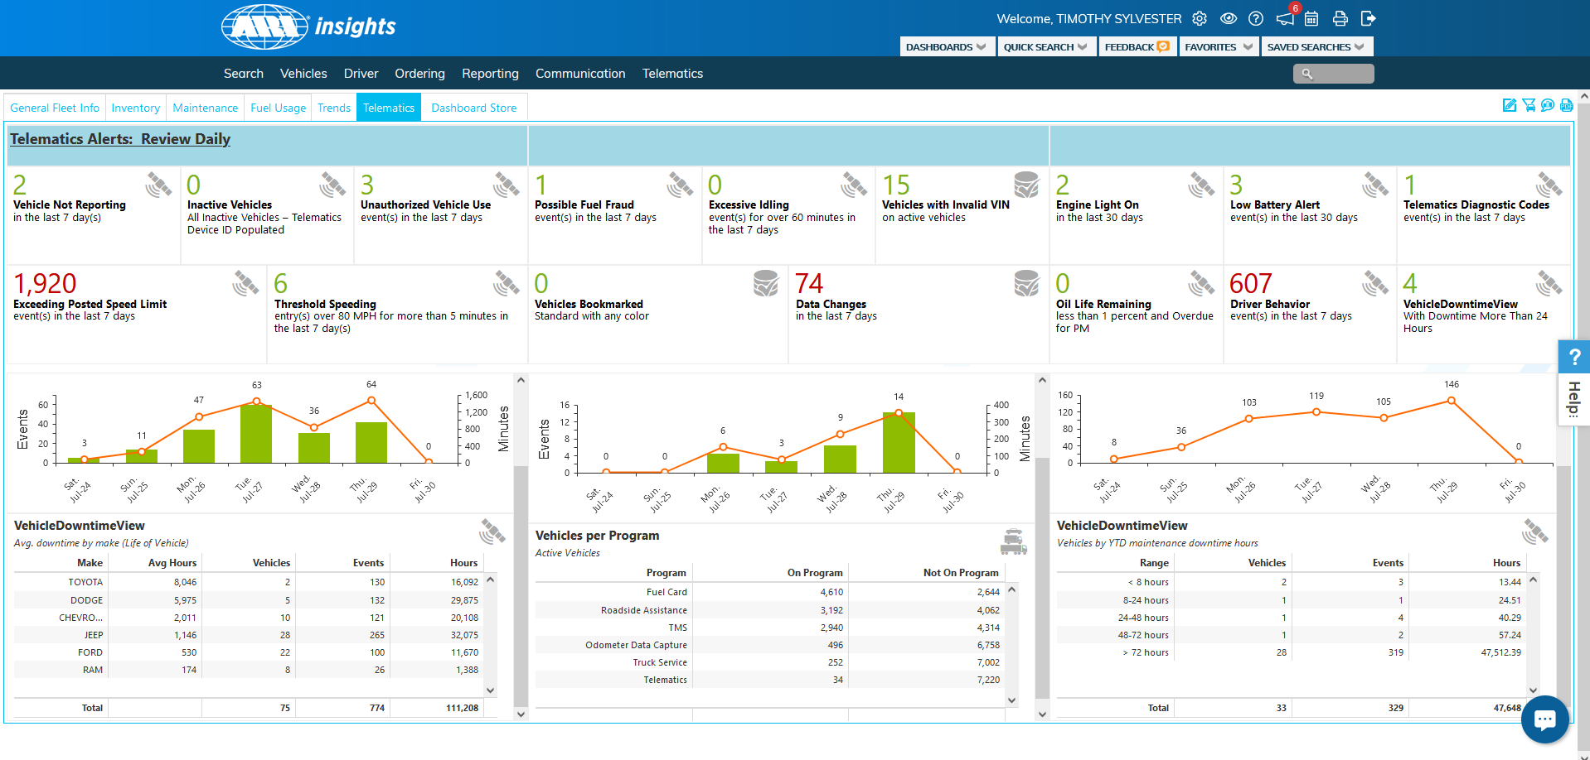
Holman Insights Dashboard/Widgets
Telematics

Slide 39
Holman Insights Dashboard/Widgets
Other facts about the dashboard
The data displayed should only be for the vehicles for your agency
In Holman, the Division is equivalent to the OASIS Cabinet and the Prefix is equivalent to the Bill Code
Widgets can be moved around
Clicking on certain data within widgets will give you a detailed vehicle listing

Slide 40
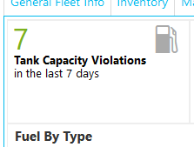
Holman Insights Dashboard/Widgets
Getting specific vehicle data from a widget
Click on a number or a piece of a graph to get an Excel style list of the vehicles that make up that widget
The example below is of 7 vehicles that went over their tank capacity in the last week

Slide 41
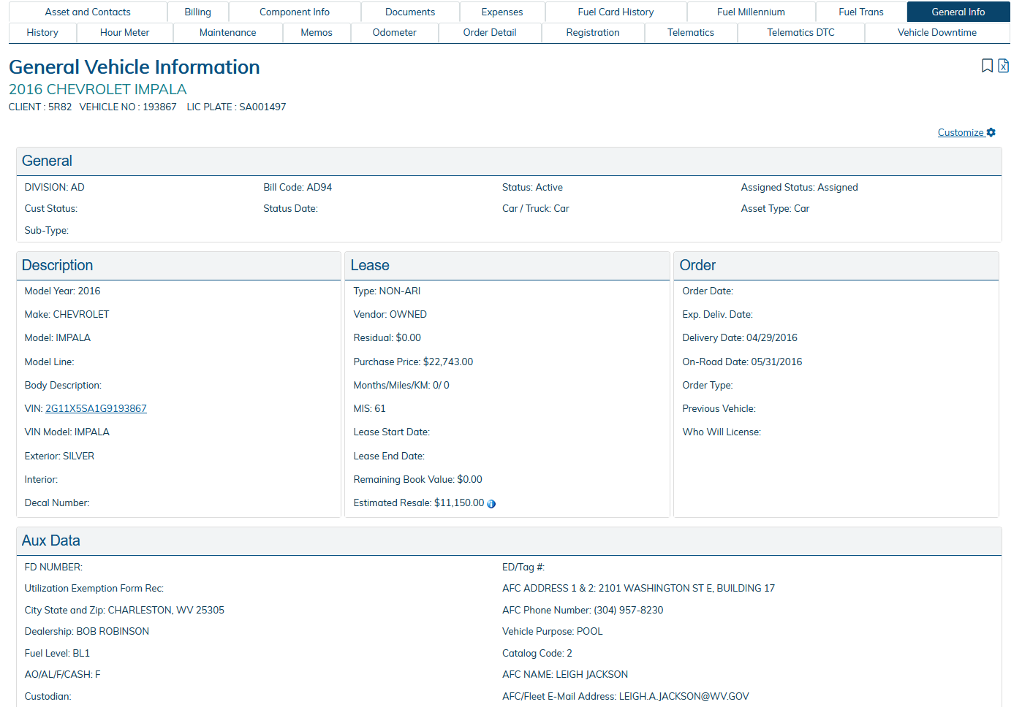
Holman Insights Quick Search
The Quick Search tab is located at the top of the Holman Insights page
You can search by a Vehicle number (last 6 of VIN), Plate Number, VIN number and First or Last name of the AFC
A quick search will show the “General Info” page of an individual vehicle

Slide 42
Holman Insights Single Vehicle
There are 6 tabs that are useful to maintaining a vehicle:
General Info
Expenses
Odometer
Maintenance
Fuel Trans
NEW – Asset and Contacts Management tab

Slide 43
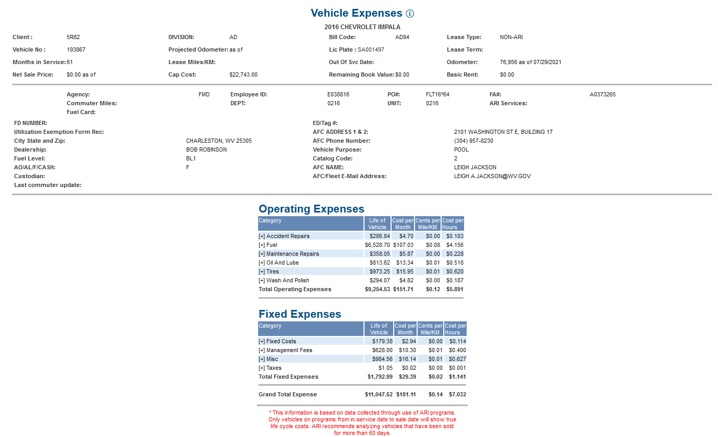
Holman Insights Single Vehicle
Expenses Tab
Shows a vehicle’s fixed and operating expenses, as well as how much that vehicle is costing an agency on a cents per month, cents per mile basis

Slide 44
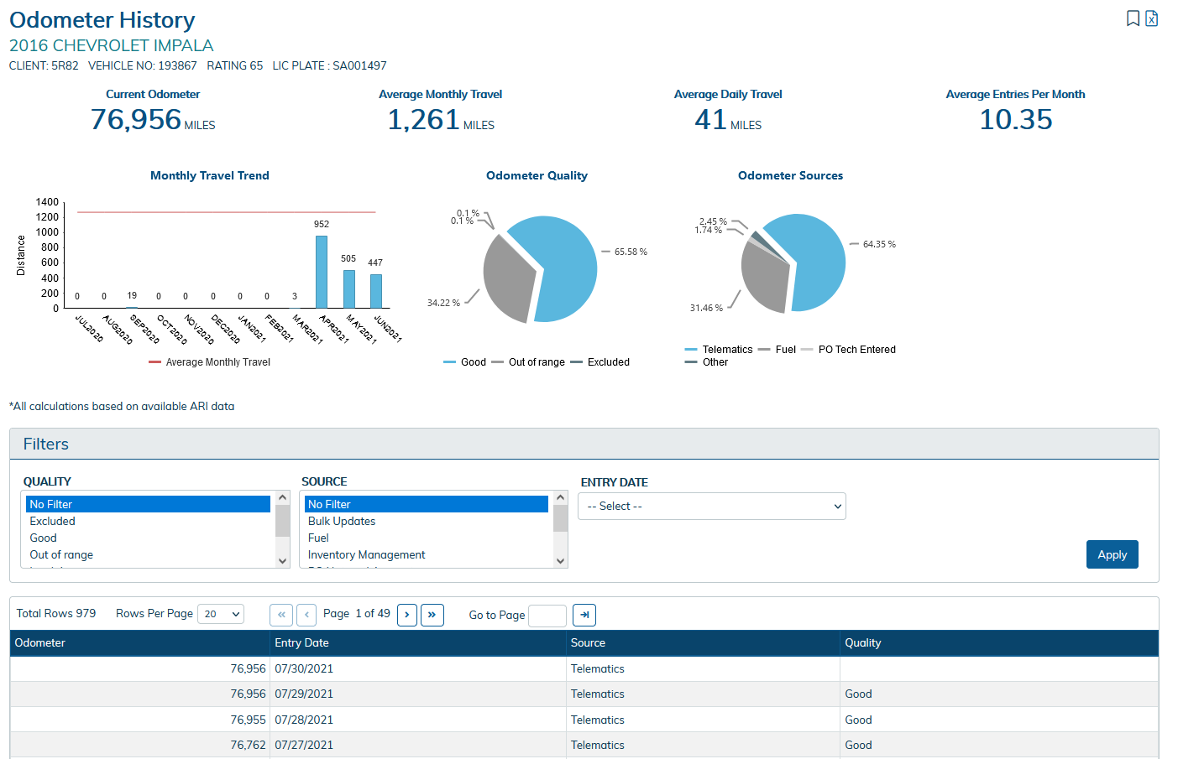
Holman Insights Single Vehicle
Odometer Tab
Shows odometer information for a vehicle

Slide 45
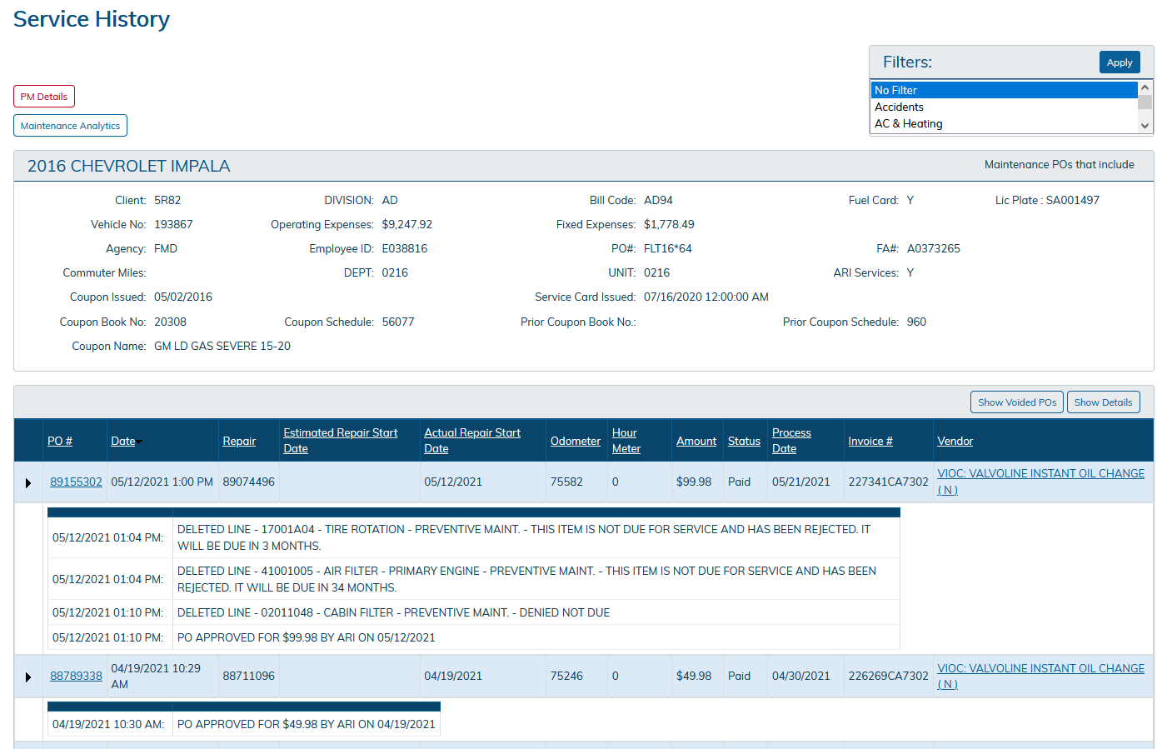
Holman Insights Single Vehicle
Maintenance Tab
Shows the service history of a vehicle, the maintenance levels of approvals for a vehicle, and the PM schedule set up for that vehicle

Slide 46
Holman Insights Single Vehicle
Asset and Contacts Management Tab
This is the tab that FMD has opened to Holman users so they can input their driver’s information on a per vehicle basis
On a one to one ratio, vehicle information an AFC or other Holman user can put in are: driver’s first and last name, the vehicle’s overnight address, a driver’s various phone numbers, and a driver’s email address
On pool vehicles, an AFC or Holman user should put in POOL for the driver’s first and last name, the vehicle’s overnight address, and the supervisor of that vehicle’s phone numbers and email
The email address that is in this section will receive recall alerts
The fields listed above must be filled into the Asset and Contacts Management tab

Slide 47
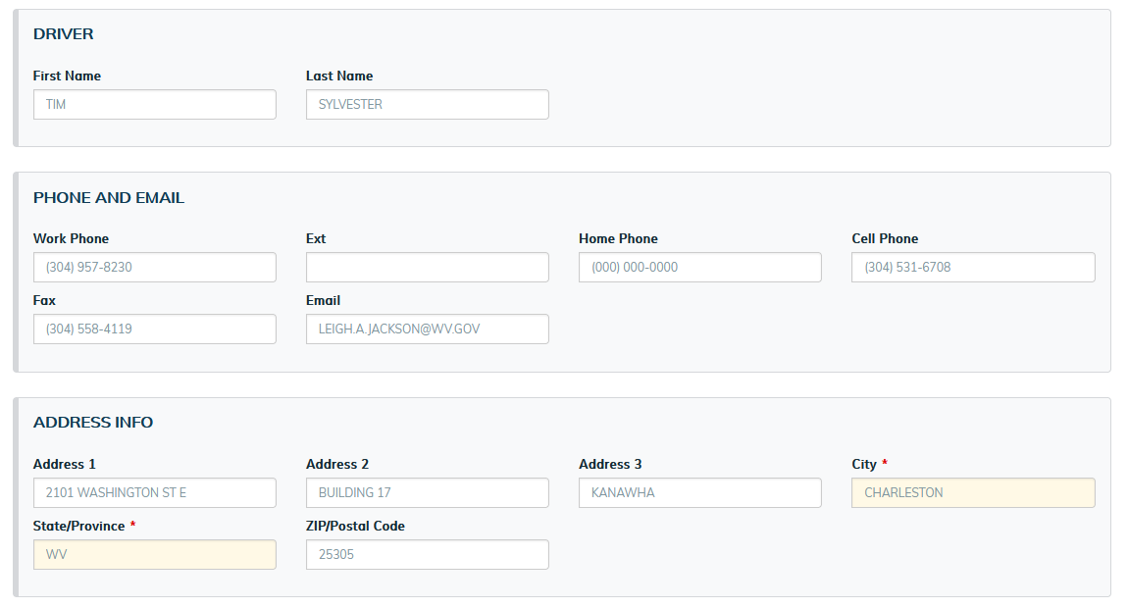
Holman Insights Single Vehicle
Asset and Contacts Management tab

Slide 48
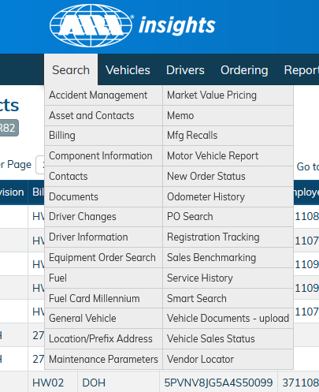
Holman Insights Search Tab
The search tab consists of many vehicle related reports
The two most used reports are General Vehicle and Asset and Contacts
These reports can be filtered and customized in multiple ways
You can save the customized reports to the Saved Searches tab

Slide 49
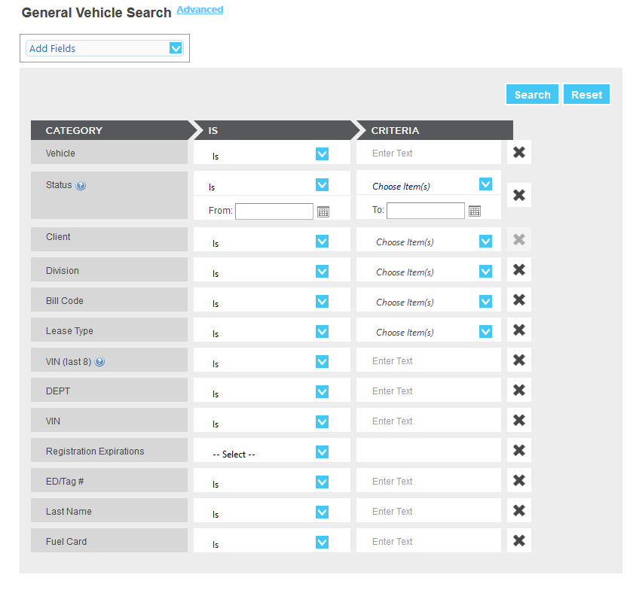
Holman Insights Search Tab
Getting general vehicle data
If you click on Search, and choose General Vehicle, it will bring up a prompt page
Here you can enter prompts into the fields already listed, or you can add new prompts from the Add Fields drop down box

Slide 50
Holman Insights Search Tab
Getting general vehicle data
Once you have all prompts entered, click Search and your data will come up in a listed format

Slide 51
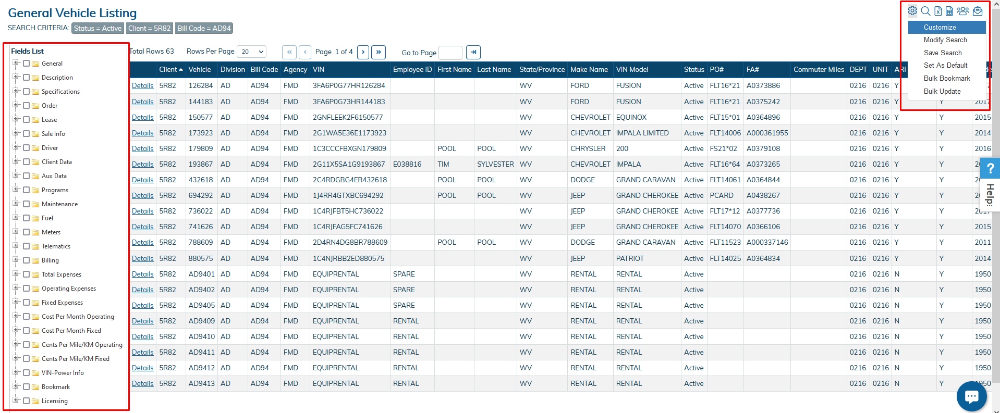
Holman Insights Search Tab
Customizing a Search
In the top right under the Options gear, select Customize
From here, you can select different fields to add to the report
Once you have all the fields you want added checked, click Apply, and the new fields will be added at the end of the report

Slide 52
Holman Insights Search Tab
Saving a Search
In the top right under the Options gear, select Save Search
At the top left of the screen, a Save Search Name box will appear where you can type in a name for this search
The saved search will save under the Saved Searches tab

Slide 53
Holman Insights Search Tab
Exporting a search as an excel file
In the top right, you will find a tiny paper with an “X” in it. Click that to export a search report to excel.

Slide 54
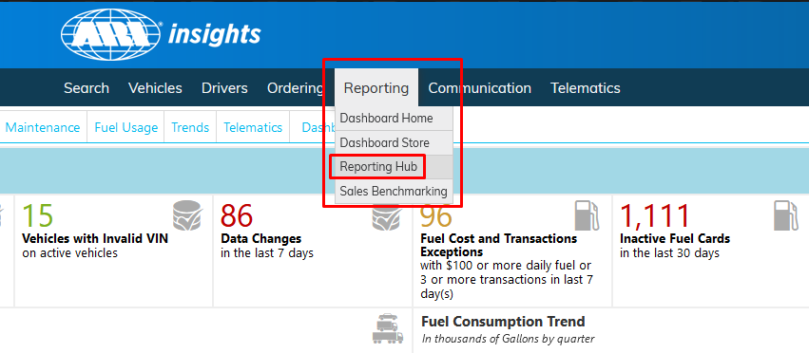
Holman Insights Reporting Tab
The Reporting Hub is located under the Reporting tab. This is where
the State of West Virginia’s detailed reports are located

Slide 55
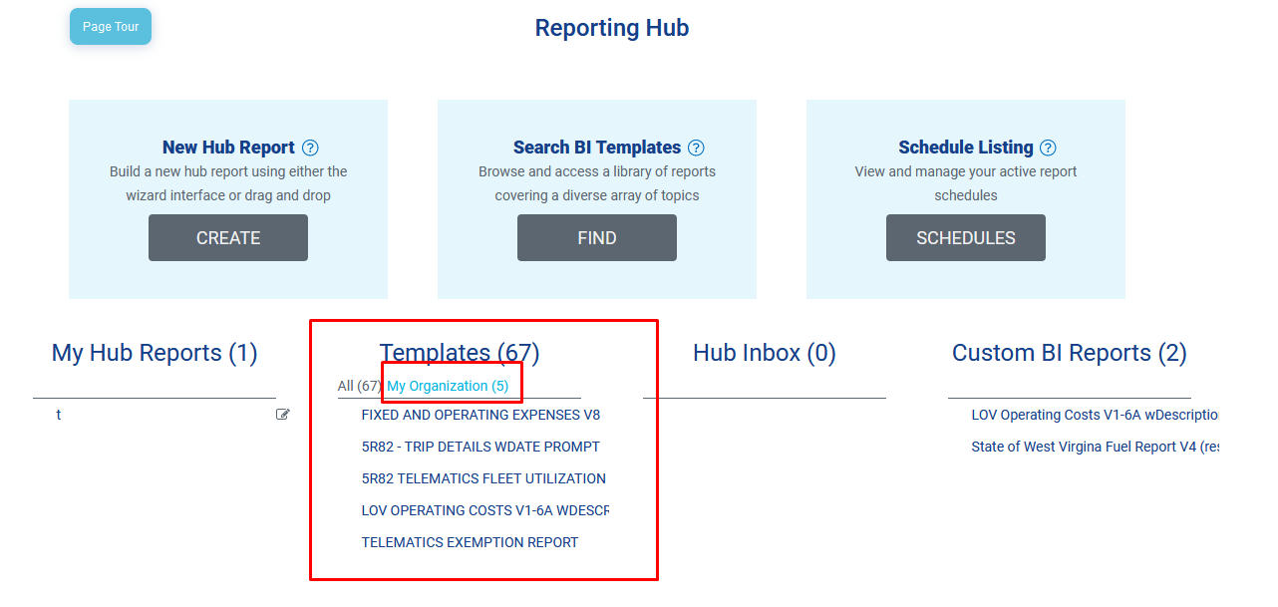
Holman Insights Reporting Tab
The most important reports that you should use are the Fixed And Operating Expenses and the LOV (Life of Vehicle) Operating Costs reports
These reports were custom built for the state of West Virginia
The Fixed And Operating Expense Report and the LOV Operating Costs report are both now located under the Templates > My Organization section If you do not have either of these reports, please let us know and we will have them added for you

Slide 56
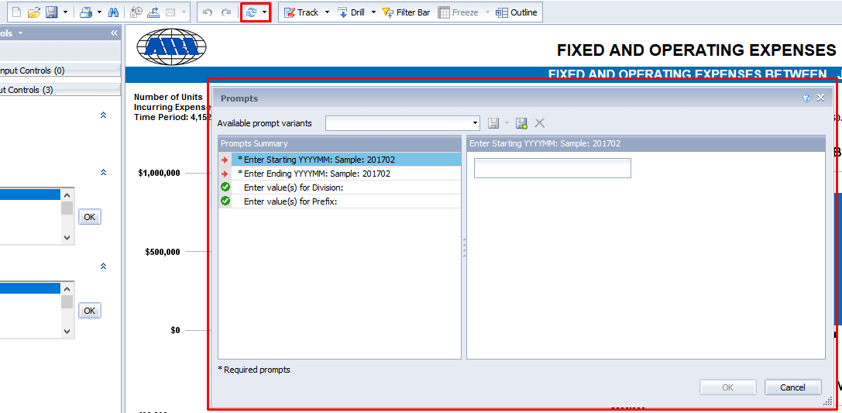
Holman Insights Reporting Tab
Fixed and Operating Report
To refresh the data, you need to click the Circle arrows button at the top of the screen
This will bring up the prompt box
Start and end dates are mandatory prompts
Date prompts need to be entered as a four digit year followed by a two digit month (EX: 201904)
Optional prompts are Division and Prefix (Division is cabinet and Prefix is Bill Code)
Multiple Divisions and Prefixes can be entered into this report

Slide 57
Holman Insights Reporting Tab
Fixed and Operating Report Tabs
1. Summary – Shows a summary of expenses in a graph format
2. Expense Summary – Shows a summarized breakout of expenses by expense type and
3. Fleet Breakouts – Shows expenses by an expense group and group detail
4. Vehicle Detail – Shows expenses per vehicle
5. Vehicle Detail2 – Shows more detailed expenses per vehicle
6. Op Exp by Qtr, Op Exp by Month, Cost PVPM, Fuel Exp by Month and CPM per
month-All are bar graphs
7. Operating exp – Shows operating expense totals
8. Definition – Gives an explanation of the report

Slide 58
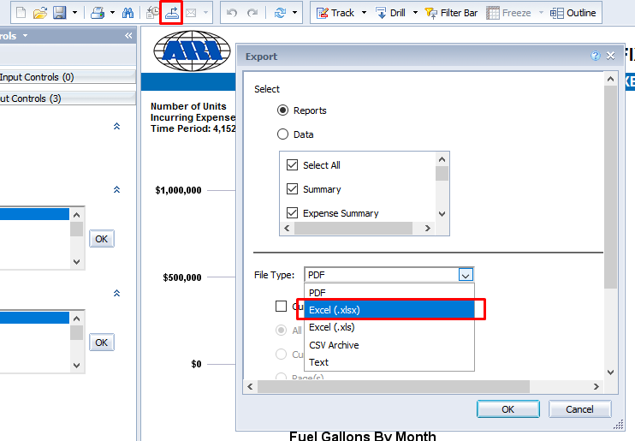
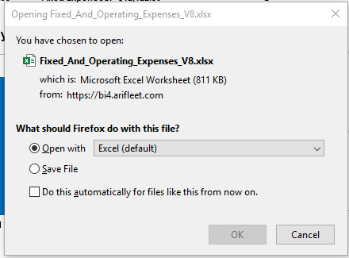
Holman Insights Reporting Tab
Saving Fixed and Operating report as an Excel file
Click on the Export button on the top left side of the screen
An export box will appear
Under File Type, select Excel (.xlsx)
This report can also be exported as a PDF
Click Ok and another prompt box should open asking if you want to open or save the file

Slide 59
Holman Insights Reporting Tab
LOV Operating Cost Report
Shows a snapshot of active vehicles and their maintenance and fuel expenses broken out in different ways
Automatically runs when you open it
Contains a description tab that describes every field on the report
Is exported to excel the same way the Fixed and Operating report is

Slide 60
Holman Insights Vehicle Purpose Field
A Vehicle Purpose field was added to Holman so that FMD can better define what vehicles are being used for
Agencies should pick and inform FMD of a purpose for each of their vehicles based on the list below and utilize the DOA-FM-021 Vehicle Purpose form to notify us of any updates/changes
A “-B” after the vehicle purpose means that that vehicle uses bulk fueling
An “-X” after the vehicle purpose field denotes a vehicle FMD does not have to contact for fueling utilization purposes

Slide 61
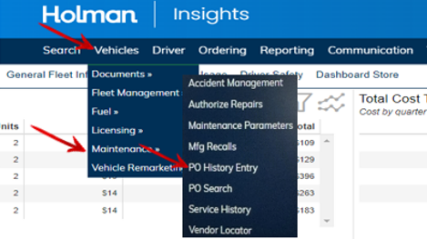
Holman Insights Adding a Manual PO
Log into Holman Insights:
From the dashboard, select the Vehicles tab > Maintenance > PO History Entry

Slide 62
Holman Insights Adding a Manual PO
On the page, select in the drop-down menu for Client ID, 5R82. Type in the last 6 digits of the vehicle’s VIN in the Vehicle Number box. Make sure that the option of PO Detail is selected. Click on the SUBMIT button

Slide 63
Holman Insights Adding a Manual PO
When this box appears, click the vehicle number link (In this example, 556830)

Slide 64
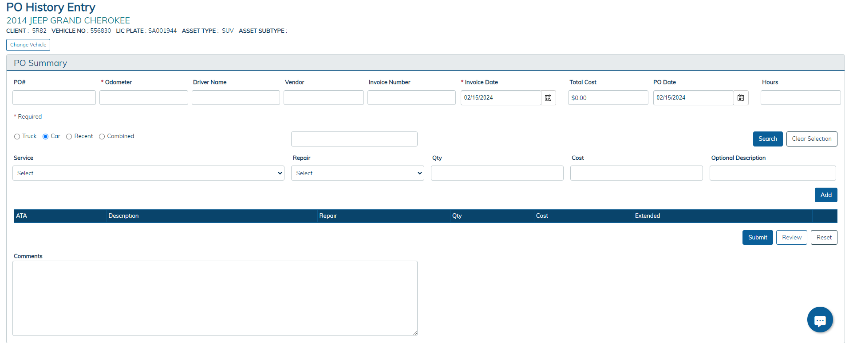
Holman Insights Adding a Manual PO
This will be the box that appears next

Slide 65
Holman Insights Adding a Manual PO
Enter in the following information
Cient PO
Meter (Odometer)
Driver Name
Vendor Name
Invoice Number
Invoice Date
PO Total
PO Date
Under the SERVICE header, use the drop down box to select what is being done (e.g. tires, batter, etc)
Under the REPAIR header, use the drop down box to select Labor, Parts, PM, or Other
Under the QTY header, enter the quantity
Under the COST header, enter the cost
Select TRUCK or CAR
Enter any additional comments needed
Click on the SUBMIT button

Slide 66
Fleet Management
Agency Fleet Coordinator Training
Part 3- Fleet Management Division’s Additional
Services and Programs
Holman/Geotab Telematics
Driver Training and Safety
Fleet Commander Kiosk System
WV Motorpool Online Reservation

Slide 67
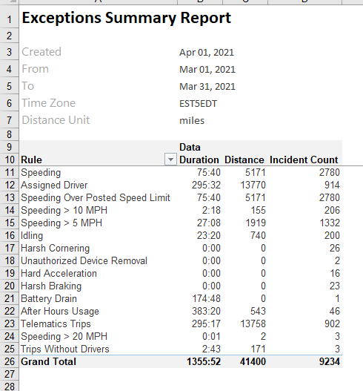
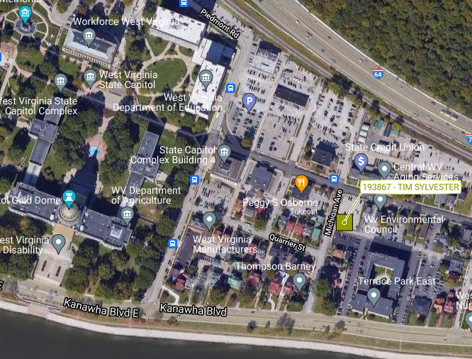
Fleet Management Division’s Services and Programs
Holman/Geotab Telematics
Telematics is a vehicle GPS unit that allows users to see data from the vehicle in real time
Holman and GeoTab offer a map that pinpoints each telematics vehicle
They also offer several reports that show trip logs, and such exceptions as speeding, idling, harsh braking, and vehicle health

Slide 68
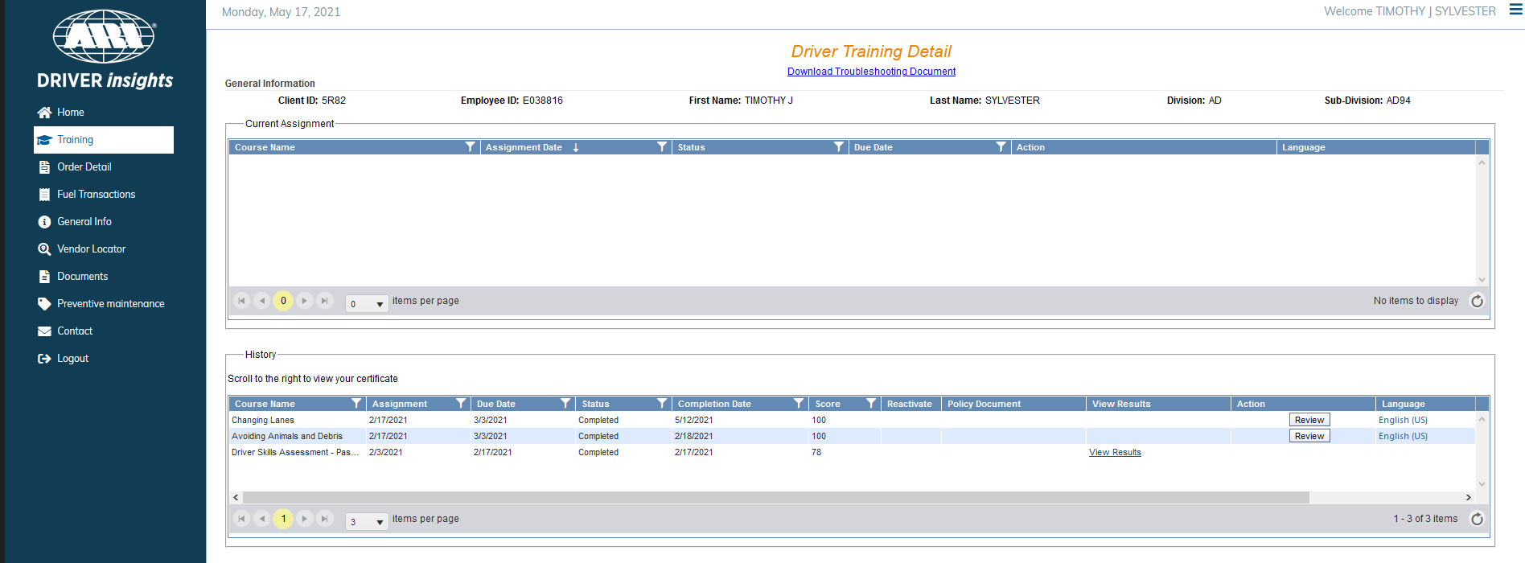
Fleet Management Division’s Services and Programs
Driver Training and Safety
Through Holman, the Fleet Management Division offers a driver safety program that has many training modules that can help educate employees to be better drivers
The detailed information on the driver safety program can be found by clicking here

Slide 69
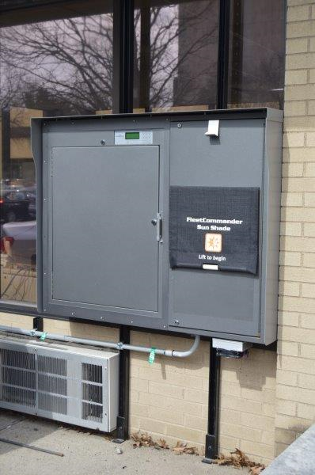
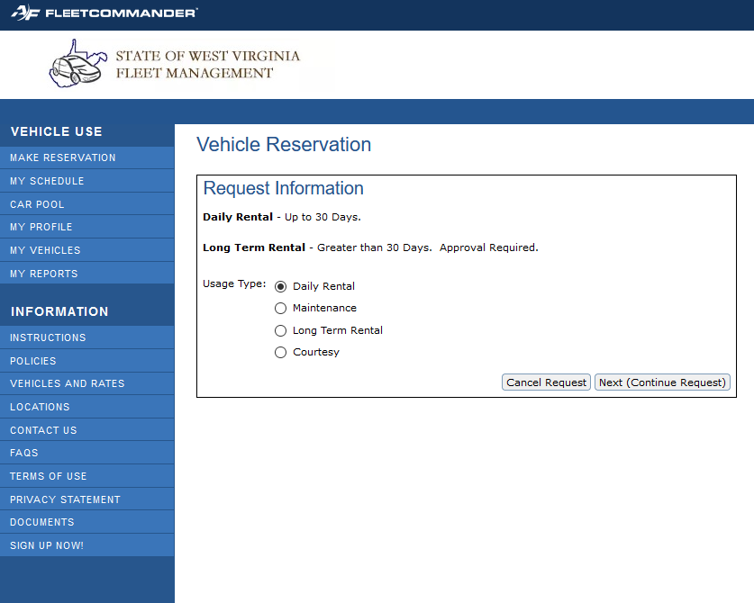
Fleet Management Division’s Services and Programs
Fleet Commander Kiosk System
Reservations for our rentals can now be made through an online KIOSK system called Fleet Commander
The reservations are made online, and the driver can pick up the keys at a lock box that is located at Elizabeth Street parking by Laidley Field
The online reservation system can be found here:

Slide 70
Fleet Management
Agency Fleet Coordinator Training
Part 4 – wvOASIS
https://myapps.wvsao.gov/apps/Portal/Default.aspx
FA, FD, FM and FC Documents in the Financial Application
Vehicle and Other Licensed Inventory Catalog Codes (02,03,32,50,24, and 85)
FARCOMP Page in the Financial Application
AM-17V Vehicle Inventory Report
AM-006 Assets Retired Report
AM-043 Asset Documents Report
Vehicle Related Expenses Through BI Reporting
Object and Sub-Object Codes

Slide 71
wvOASIS
FA Documents
Fixed Asset Acquisition document
Document used to put an asset into OASIS
FMD creates the FA documents for the vehicles that are financed through them
The agencies create FA documents for the vehicles that they own
When entering vehicles, it is important to be as descriptive as possible
Component-Specification tab important items:
Vehicle Make = The make of the vehicle
Vehicle Model = The vehicle model
Vehicle Year = The vehicle’s model year
Serial Number = The VIN of the vehicle
VIN = The VIN of the vehicle

Slide 72
wvOASIS
FA Documents (Cont.)
Component-Component Classification Fixed Asset Catalog
02 = 1 Ton and Under vehicles
1 Ton and Under is not based on weight, rather it is based on a classification of vehicles
EX: F-350, Ram 3500, Silverado 3500 and under would be considered 1 Ton and Under
03 = Over 1 Ton
Also not based on weight, but based on a classification of vehicles
EX: F-450, Ram 4500, Silverado 4500 and up would be considered over 1 Ton
32 = Agency 3rd-party Leased vehicles
Vehicles that an agency leases for a year or more from a private company
50 = Licensed Trailers
24 = Licensed Mobile Homes
85 = All Terrain Vehicle – ATV Licensed*
Differentiated from catalog code 84 All Terrain Vehicle – ATV Unlicensed catalog code

Slide 73
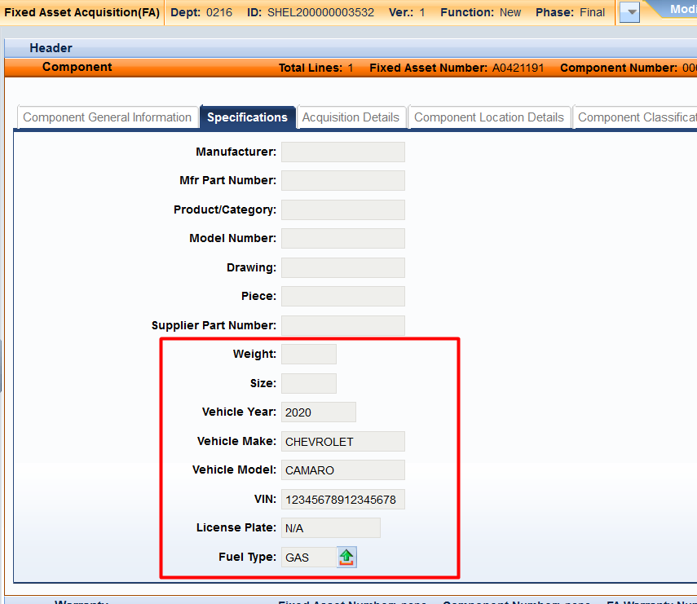
wvOASIS
FA Documents
Component-Specification tab includes fields you must use when you enter a vehicle into wvOASIS and what fields you can use additionally
Required fields
Vehicle Make
Vehicle Model
Vehicle Year
You will use both Serial Number and VIN fields to record the vehicle’s VIN number
Optional fields
Weight
Size
License Plate
Fuel Type

Slide 74
wvOASIS
FD Documents
Used to retire a vehicle
When an agency is exempt from WVSASP, FMD will approve the FD once the required documentation is attached to the header
Applicable documents will depend on the disposition method. Review Add a Fixed Asset Disposal (FD) (Retirement) instructions available under the Helpful Links section of our site https://fleet.wv.gov/AFC_Resources/Pages/default.aspx
Pending FDs for FMD owned vehicles are reviewed every three months
Methods of disposition for a vehicle
DTSP (Deliver to WVSASP)
ONST (Sell onsite)
TRAD (Trade-in)
SCRP (Sell for scrap)
RECY (Recycle/dispose as waste)
LOST (Lost asset)
INTS (Internal sale)
STOL (Stolen asset)
DEST (Destroyed asset/total loss)
CLEA (Canceled 3rd-party leased vehicle)
WAST (Dispose as waste)
UNAU (Unauthorized Disposal)

Slide 75
wvOASIS
FM Documents
Used to modify existing vehicles in OASIS
Things that usually get modified include:
Vehicle Year, Make or Model
VIN numbers
Requires approval from WVSASP with documentation attached to the header
Catalog codes
Custodian codes
FC Documents
Used to cancel a fixed asset entry in wvOASIS
Usually used to cancel duplicate fixed asset entries of the same VIN
Should be used if financial details included on FA entry were incorrect. The Accounting tab cannot be modified with an FM document

Slide 76
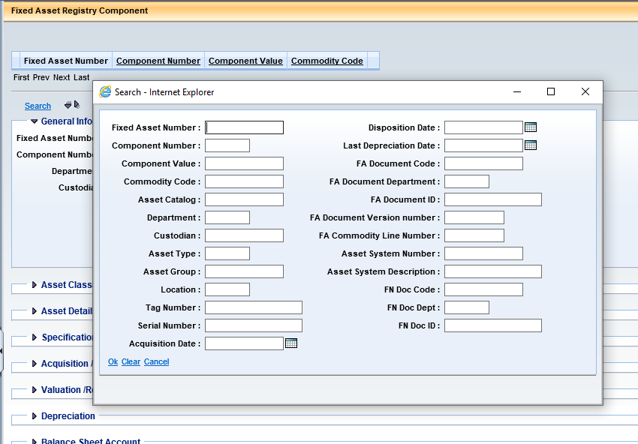
wvOASIS
FARCOMP
This is the OASIS Financial Application page that you can search for active assets
Can search on multiple fields, the two most used being Fixed Asset Number and Serial Number
An asterisk (*) can be used as a wild card in any search field
Ex: Serial Number can be searched using the last six of the VIN *012345

Slide 77
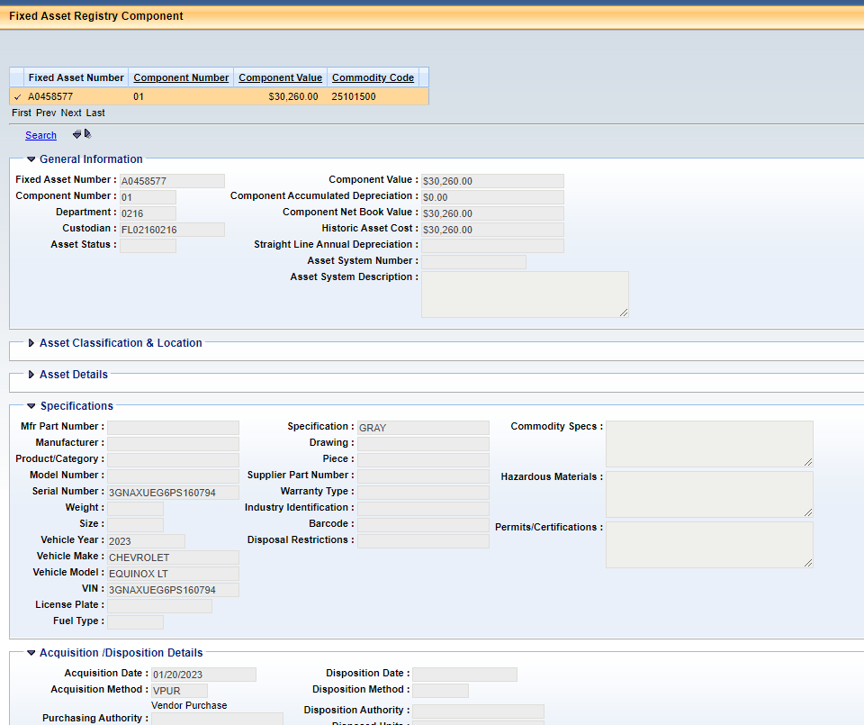
wvOASIS
FARCOMP (Cont.)
The Department of Motor Vehicles Requires a printout of the FARCOMP page with the General Information, Specification, and Acquisition/Disposition tab expanded in order to get a license plate for a vehicle

Slide 78
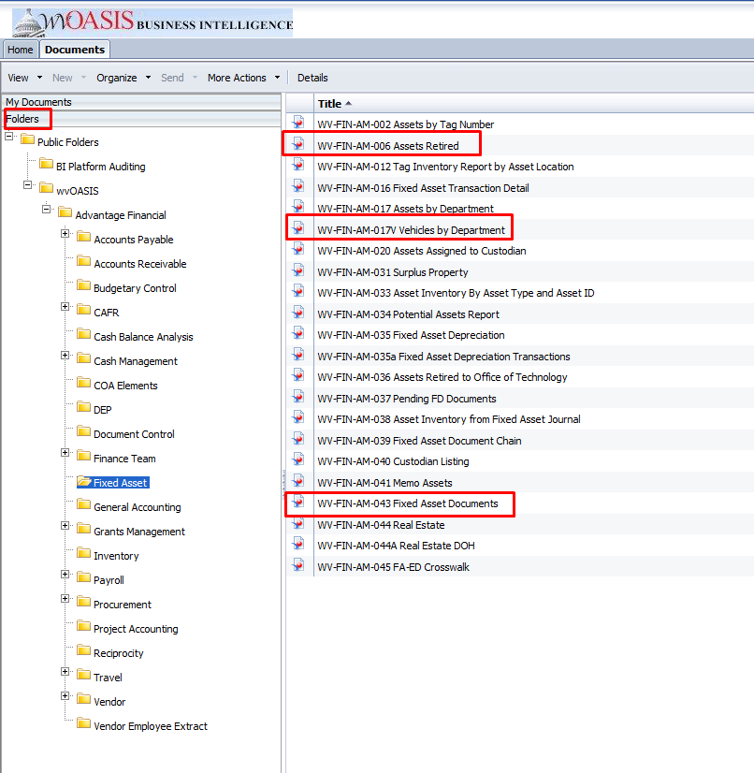
wvOASIS
Fixed Asset BI Reports
WV-FIN-AM-017V Vehicles by Department
WV-FIN-AM-006 Assets Retired
WV-FIN-AM-043 Fixed Asset Documents

Slide 79
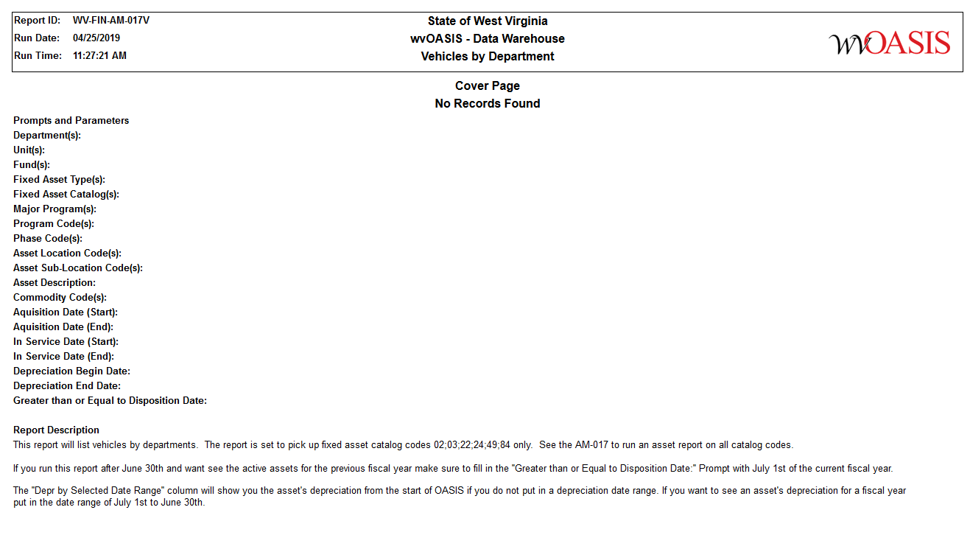
wvOASIS
Fixed Asset BI Reports
WV-FIN-AM-017V Licensed Inventory by Department
Shows an OASIS inventory of the vehicles you own
Run for catalog codes 02;03;32;50;85;24

Slide 80
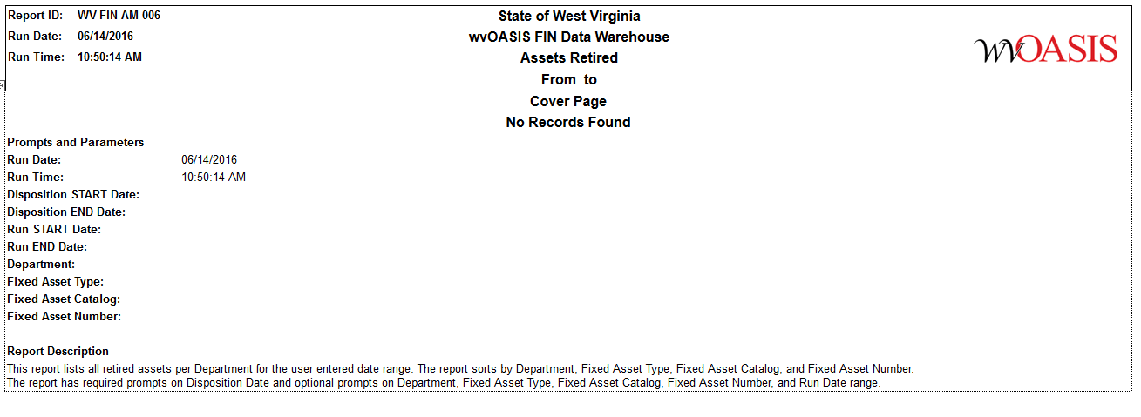
wvOASIS
Fixed Asset BI Reports
WV-FIN-AM-006 Assets Retired
Will show the licensed inventory that has been decommissioned in OASIS
Run for catalog codes 02;03;32;50;85;24

Slide 81
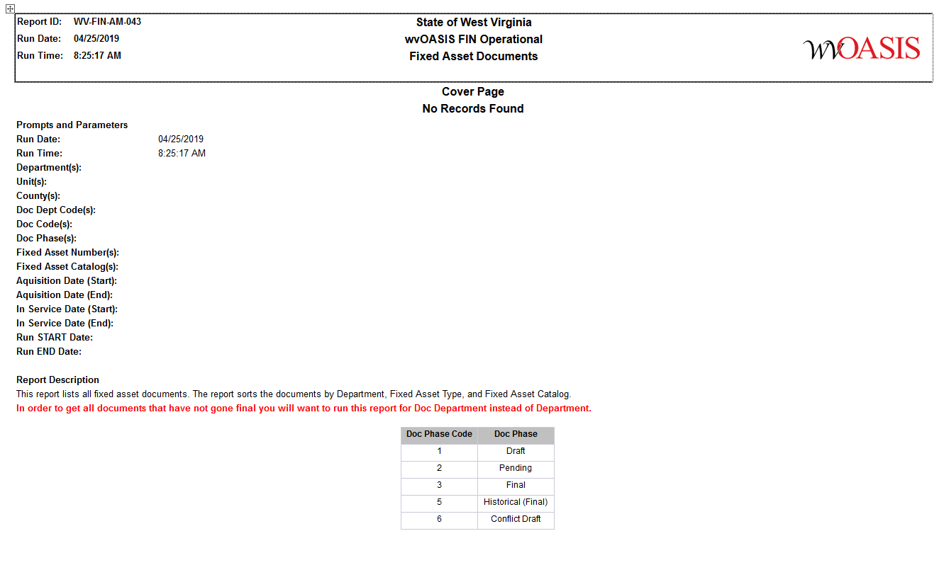
wvOASIS
Fixed Asset BI Reports
WV-FIN-AM-043 Fixed Asset Documents
Will show all fixed asset documents in any state or phase
Run for catalog codes 02;03;32;50;85;24 to see licensed asset related documents

Slide 82
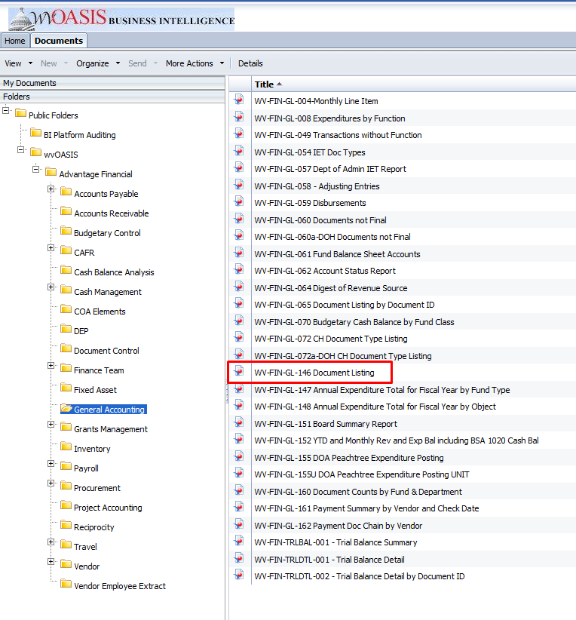
wvOASIS
Vehicle Expense Reporting in Business Intelligence
WV-FIN-GL-146 Document Listing
Certain Objects and Sub-objects will list out all vehicle related expenses

Slide 83
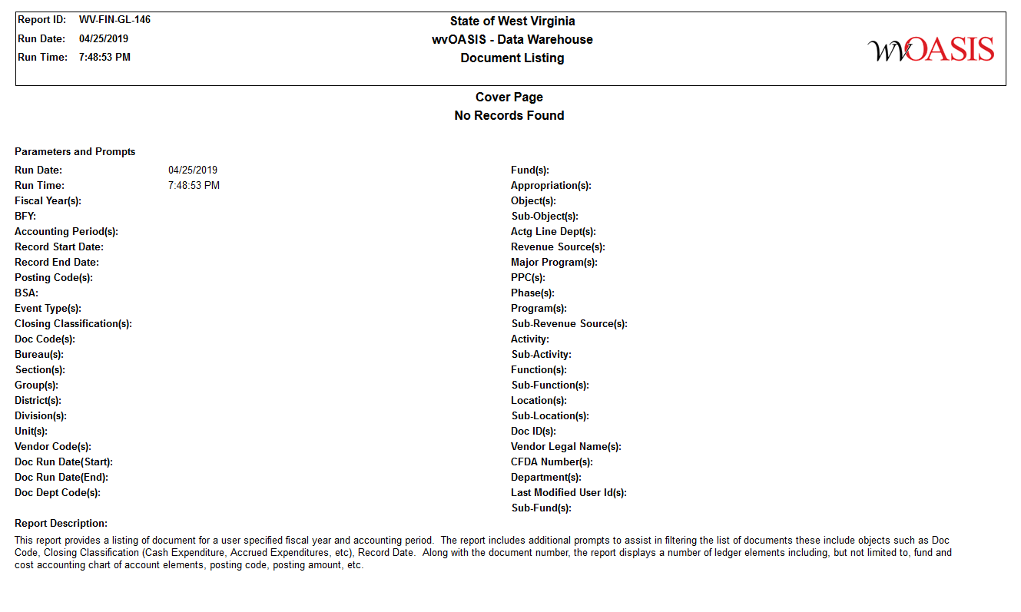
wvOASIS
WV-FIN-GL-146

Slide 84
wvOASIS
WV-FIN-GL146 prompts to enter
Mandatory prompt for Fiscal Year (For annual report run this for previous fiscal year)
Enter a Closing Classification of 10 which is Cash Expenditures
Enter Object codes 3211;3212;3216;3225;3235;3265;5211;6105
Enter Sub-object codes 3516;3517;3520;3523;3524;3527;4087;4232;4233;H127;T000;3530;3531;3534;3537;3538;3541;4217;4218;4221;4224;4225;4228;H128;T000;3569;3570;3571;3572;4001;4344;H132;T000;3614;3615;3616;3617;3619;3620;3621;H140;T000;3657;3659;4358;H150;T000;3842;5315;5316;5317;5318;5342;H302;T000;6000;6211;H256;T000
You should only see data for your department based on OASIS security
These prompts will show all vehicle related expenses for a fiscal year

Slide 85
THANK YOU FOR ATTENDING
The Fleet Management Division appreciates the teamwork each of you provide to the State of West Virginia’s management of the state’s vehicle assets.
If any agency would like a fleet review that highlights vehicle utilization and correct sizing, please contact anyone at FMD
This completes the 2023 AFC four-part virtual training

Slide 86
Contacts
Fleet@wv.gov
Director: Kenny Yoakum - Kenny.H.Yoakum@wv.gov
Fleet Manager: Michele Cunningham – Michele.D.Cunningham@wv.gov
Fleet Administrator: Beth Redden – Beth.A.Redden@wv.gov
Maintenance Analyst: James Parsons - James.A.Parsons@wv.gov
Fleet Assistant: Chena Hill - Chena.G.Hill@wv.gov
Fleet Coordinator: Stephanie Lane - Stephanie.E.Lane@wv.gov
Fuel Analyst: Teresa Taylor - Teresa.D.Taylor@wv.gov
Fleet Assistant: Leigh Jackson – Leigh.A.Jackson@wv.gov
Fleet Assistant: Lori Harper - Lori.M.Harper@wv.gov
Hours of Operation: Monday-Friday 8am-4pm
Call Toll Free: 1-855-817-1910
After Hours Number: (304) 414-0058

